Slide 1
Web API

Slide 2
Introduction
API:
In computer programming, an application programming interface (API) is a set of subroutine definitions, protocols, and tools for building software and applications.
ASP.NET Web API
The ASP.NET Web API is an extensible framework for building HTTP based services that can be accessed in different applications on different platforms such as web, windows, mobile etc. It works more or less the same way as ASP.NET MVC web application except that it sends data as a response instead of html view. It is like a webservice or WCF service but the exception is that it only supports HTTP protocol.

Slide 3
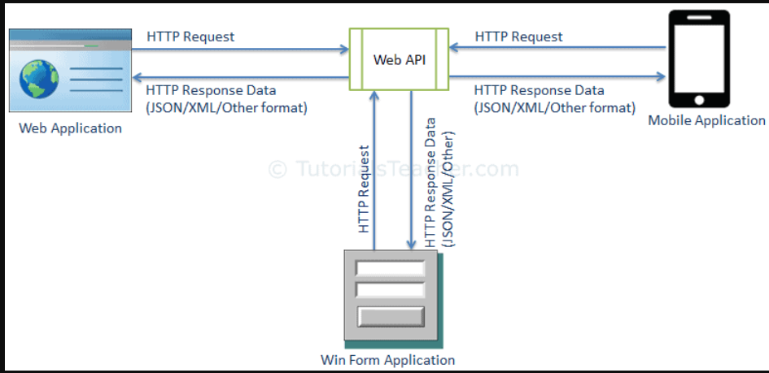

Slide 4
ASP.NET Web API Characteristics
ASP.NET Web API is an ideal platform for building RESTful services.
ASP.NET Web API is built on top of ASP.NET and supports ASP.NET request/response pipeline
ASP.NET Web API maps HTTP verbs to method names.
ASP.NET Web API supports different formats of response data. Built-in support for JSON, XML, BSON format.
ASP.NET Web API can be hosted in IIS, Self-hosted or other web server that supports .NET 4.0+.
ASP.NET Web API framework includes new HttpClient to communicate with Web API server. HttpClient can be used in ASP.MVC server side, Windows Form application, Console application or other apps.

Slide 5
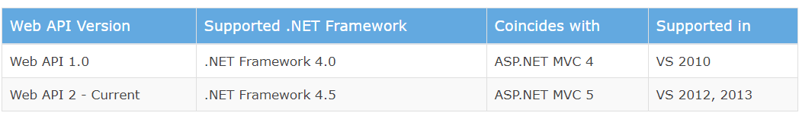
Version

Slide 6
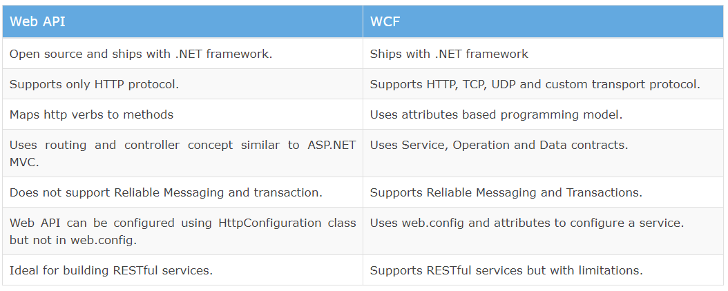
Web API vs WCF

Slide 7
When to choose WCF?
Choose WCF if you use .NET Framework 3.5. Web API does not support .NET 3.5 or below.
Choose WCF if your service needs to support multiple protocols such as HTTP, TCP, Named pipe.
Choose WCF if you want to build service with WS-* standards like Reliable Messaging, Transactions, Message Security.
Choose WCF if you want to use Request-Reply, One Way, and Duplex message exchange patterns.
When to choose ASP.NET Web API?
Choose Web API if you are using .NET framework 4.0 or above.
Choose Web API if you want to build a service that supports only HTTP protocol.
Choose Web API to build RESTful HTTP based services.
Choose Web API if you are familiar with ASP.NET MVC.

Slide 8
Content-Negotiation, MediaType Formatter,FromUri,FromBody

Slide 9
Get Method

Slide 10
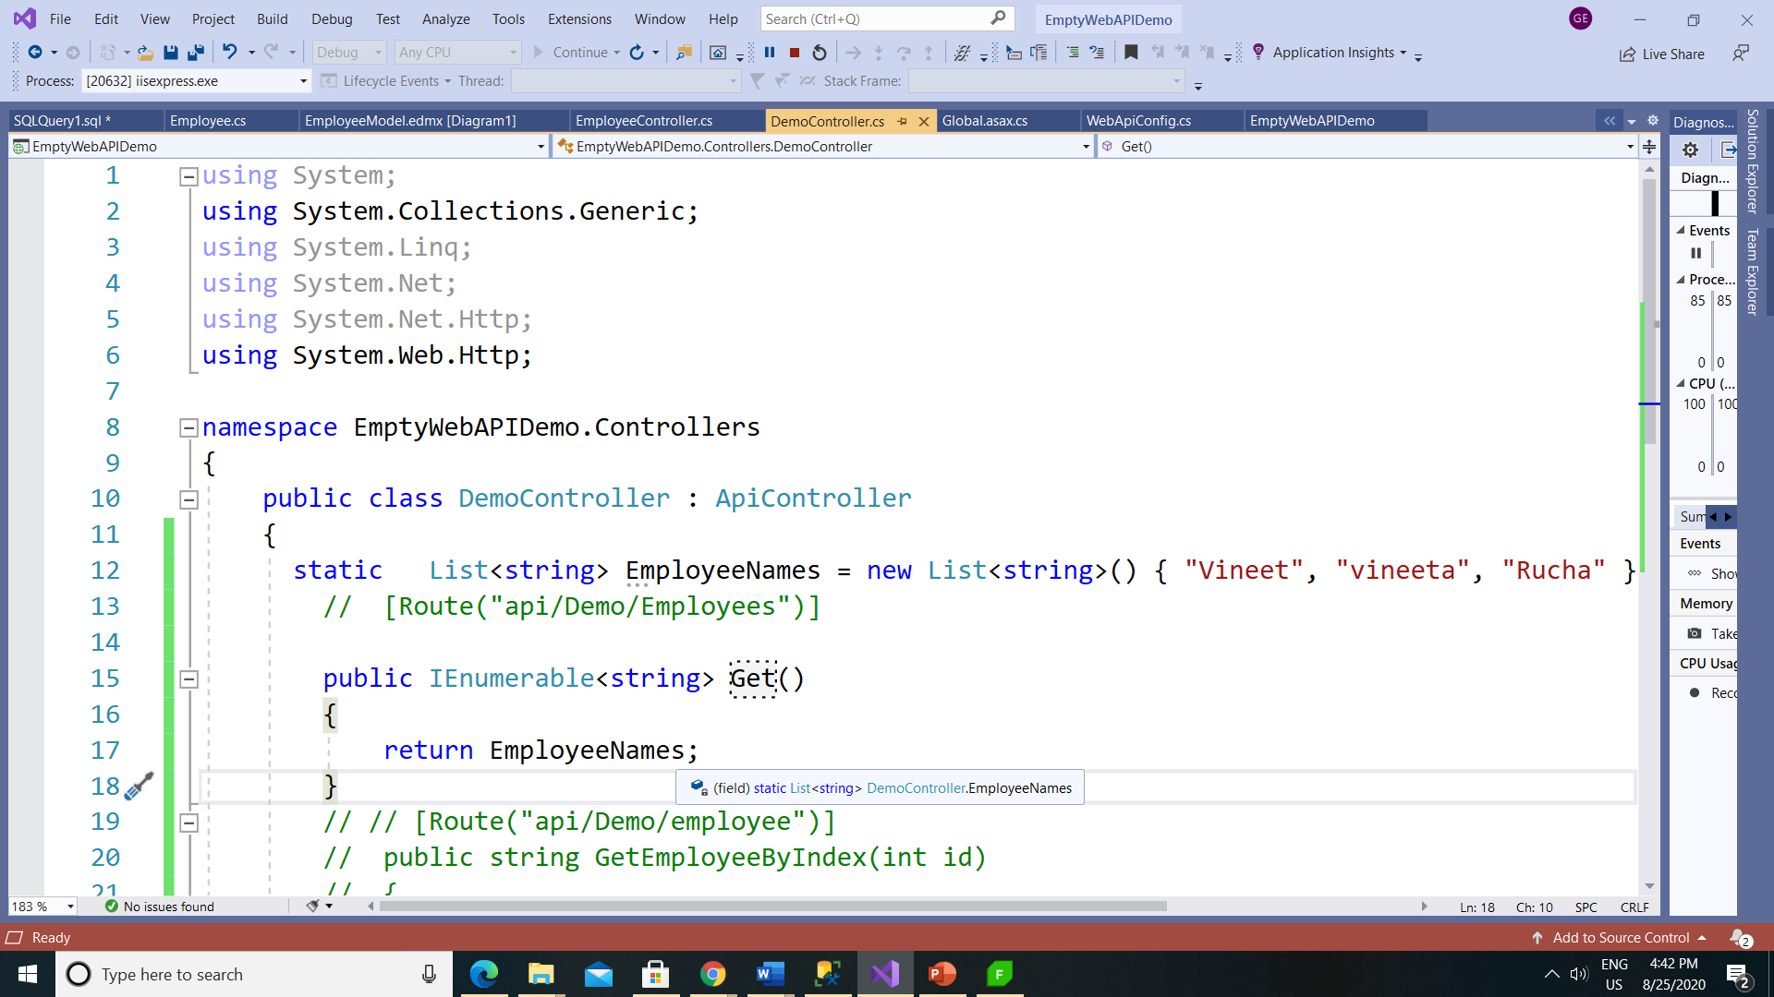

Slide 11
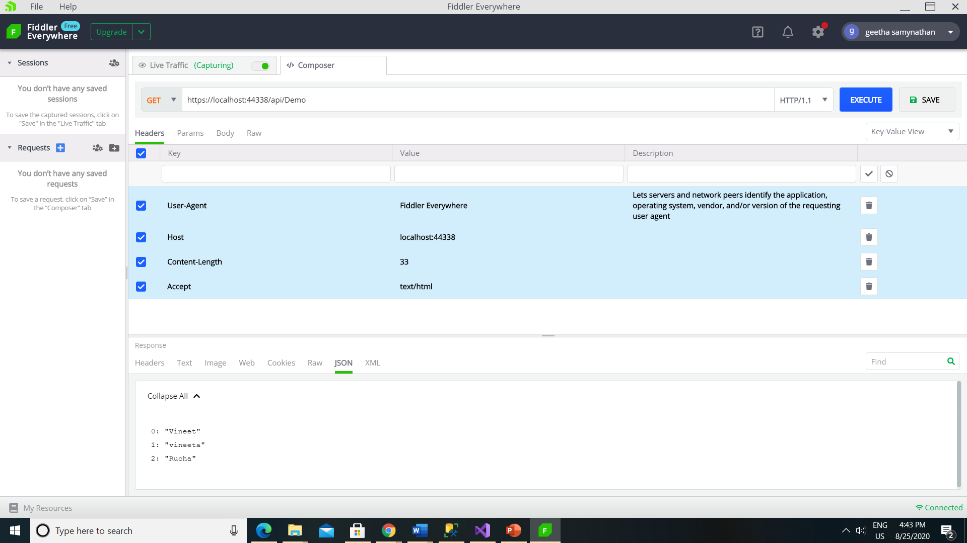

Slide 12
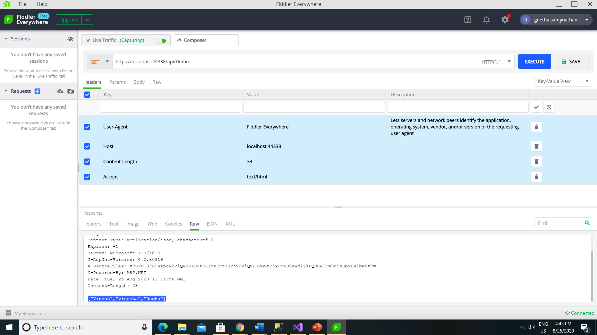

Slide 13
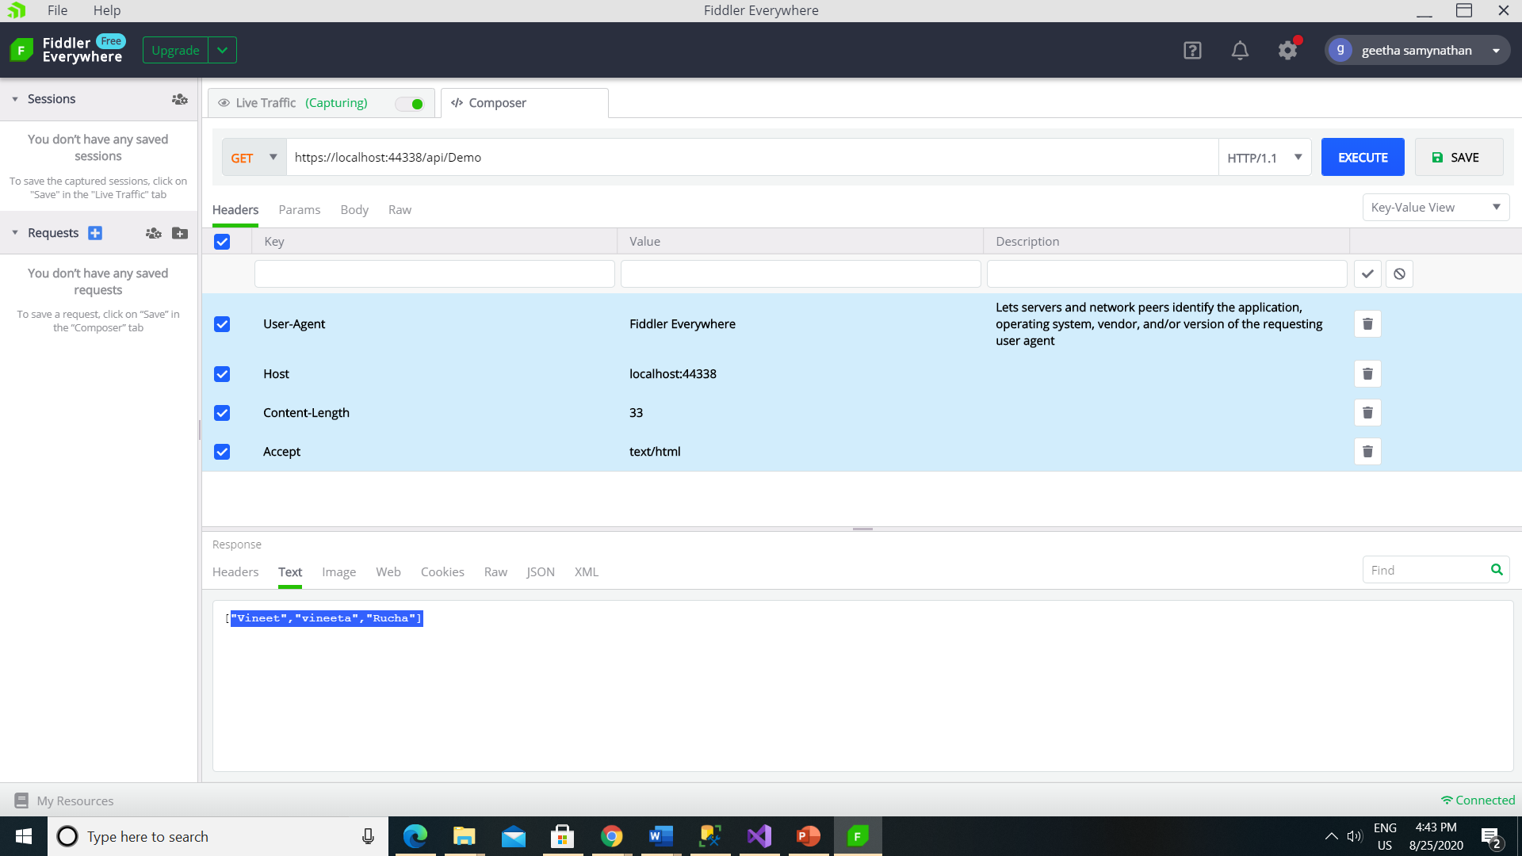

Slide 14


Slide 15
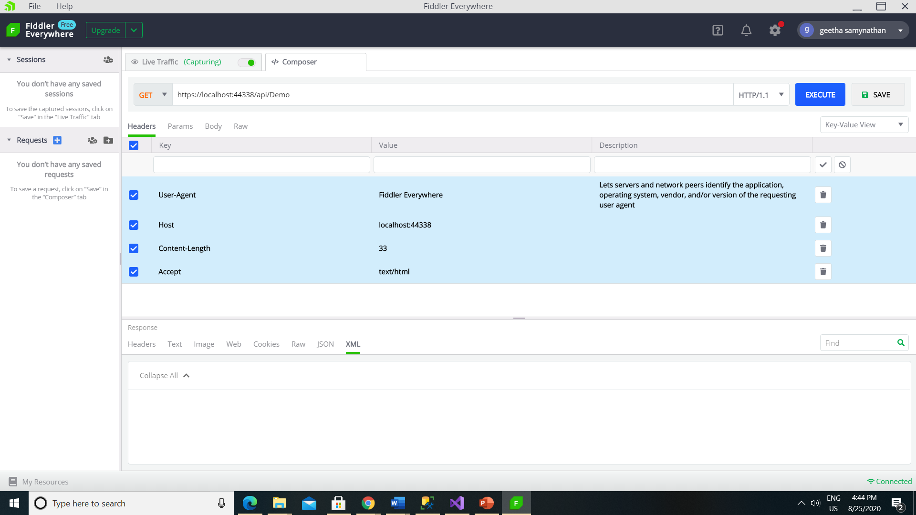

Slide 16
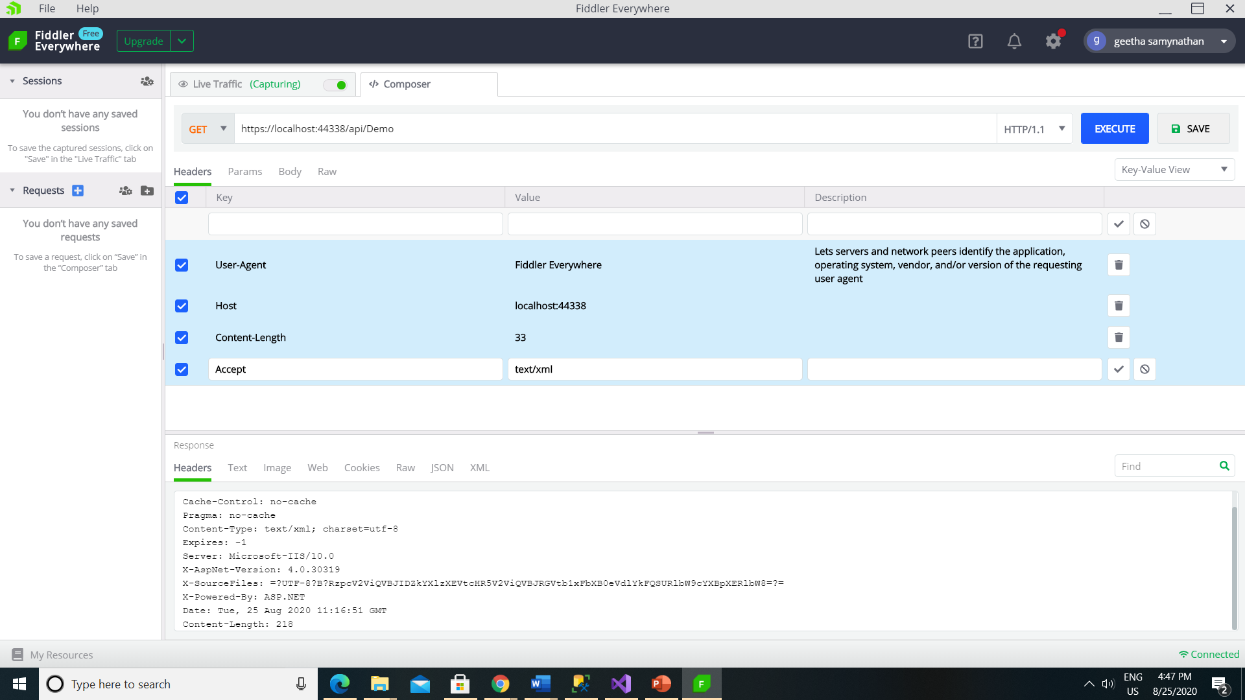

Slide 17
It will display the response in Xml,Raw,Web,Text in Xml Format.
Json tab is not showing the data.

Slide 18
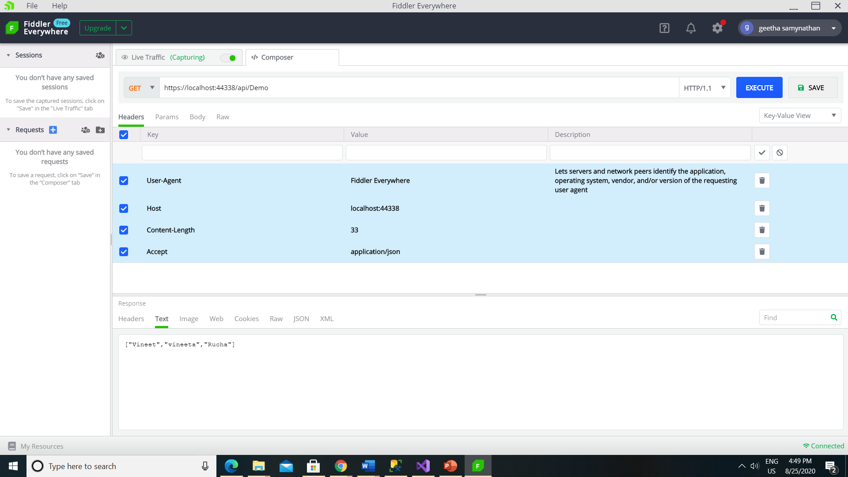

Slide 19
It will display the response in json,Raw,Web,Text in json Format.
XML tab is not showing the data.
In Accept header we can pass the value as “application/json” or “text/json”.

Slide 20
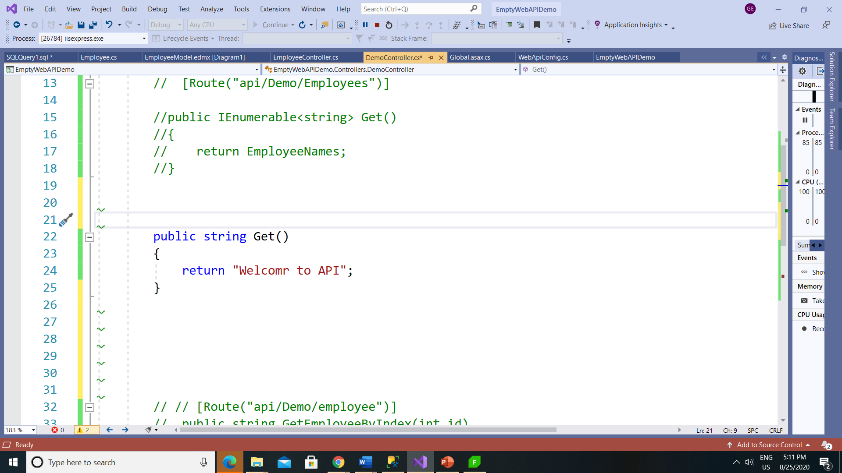

Slide 21
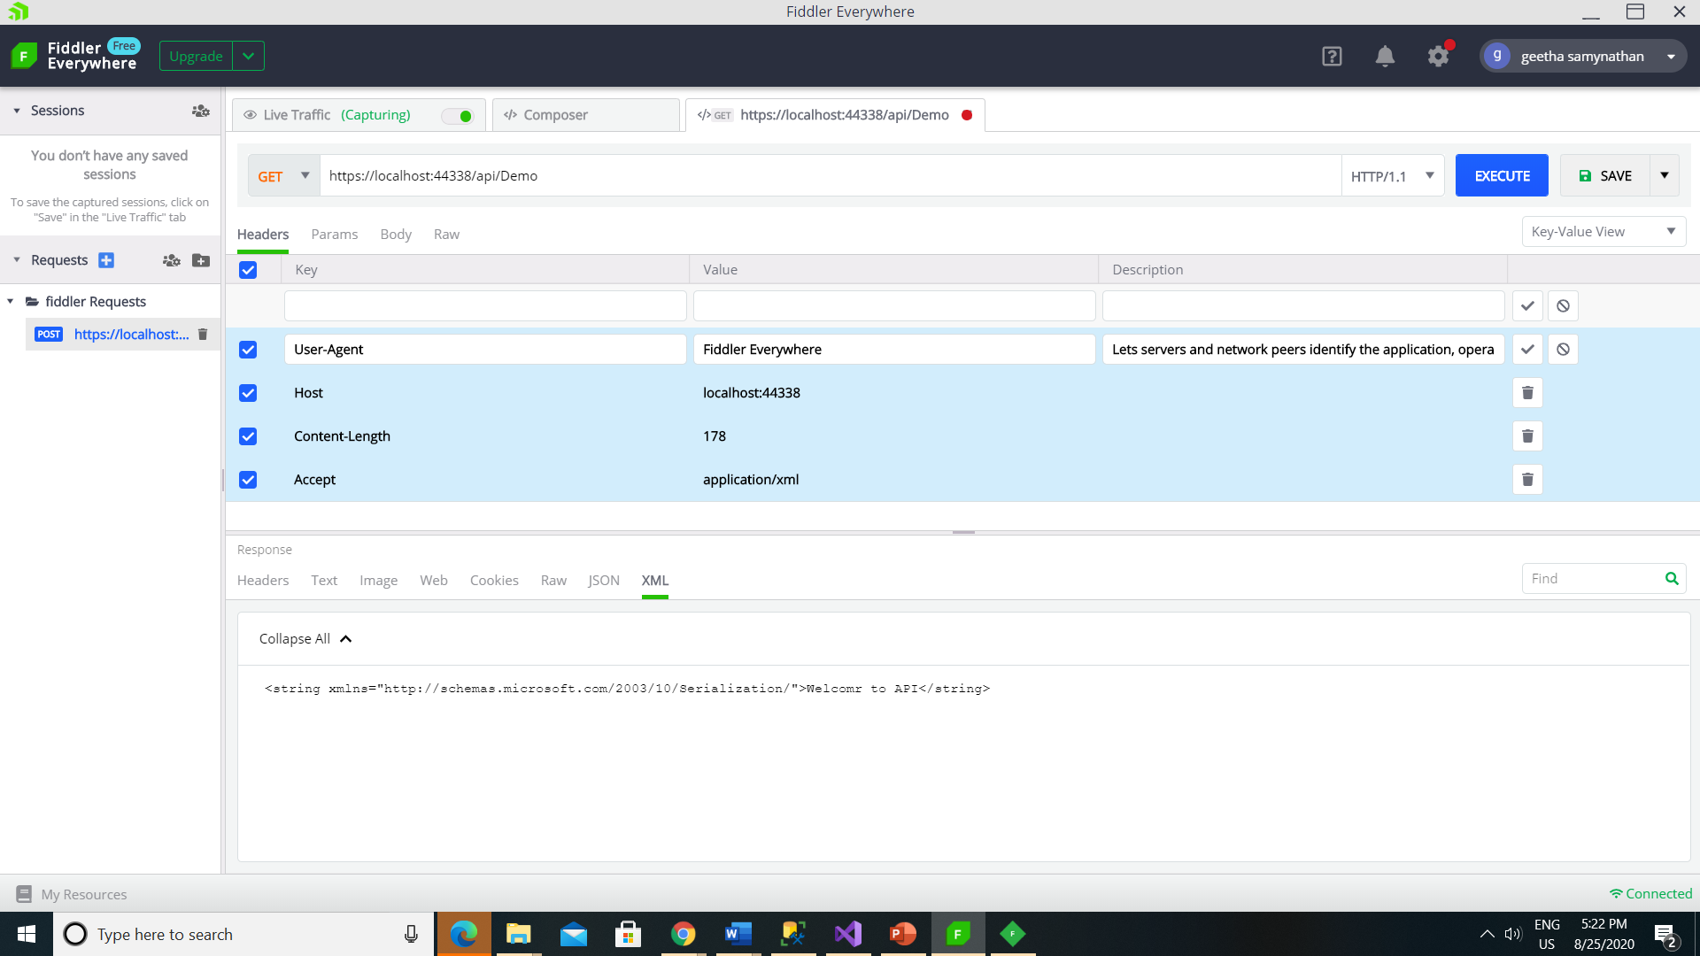

Slide 22
Post Method

Slide 23
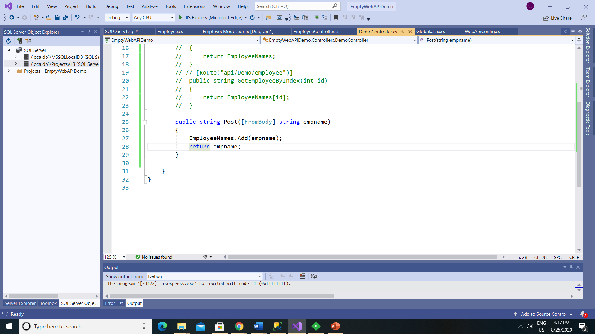

Slide 24
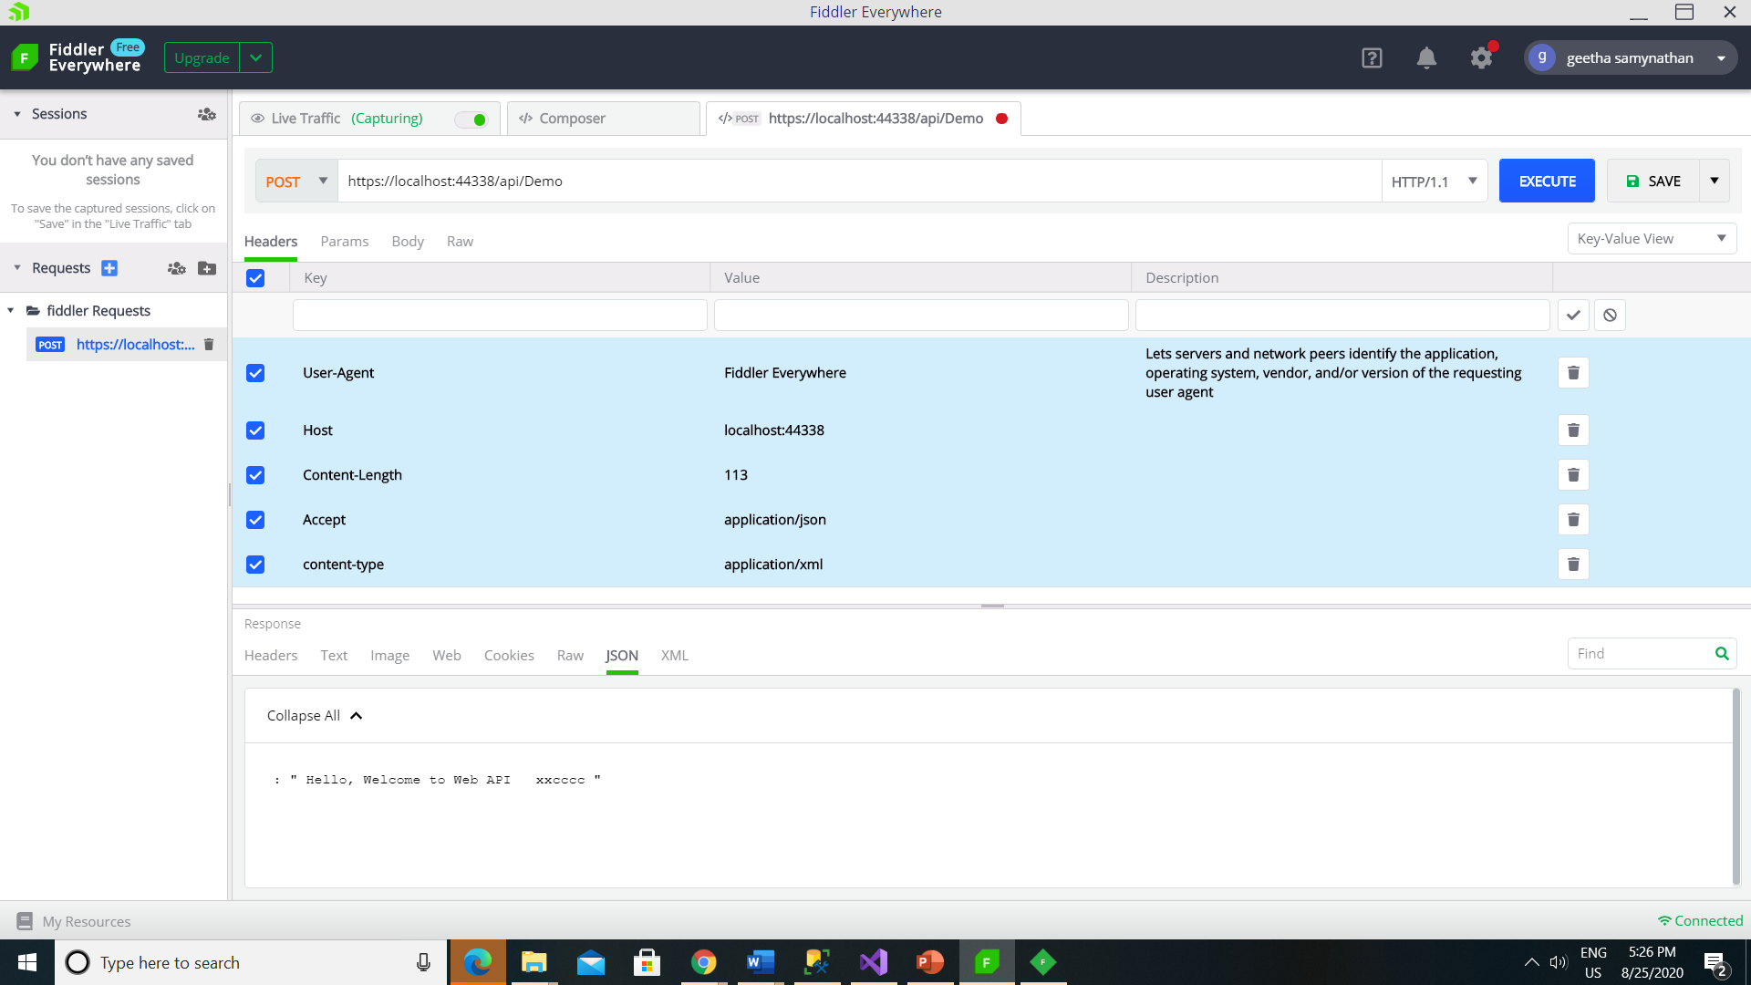

Slide 25
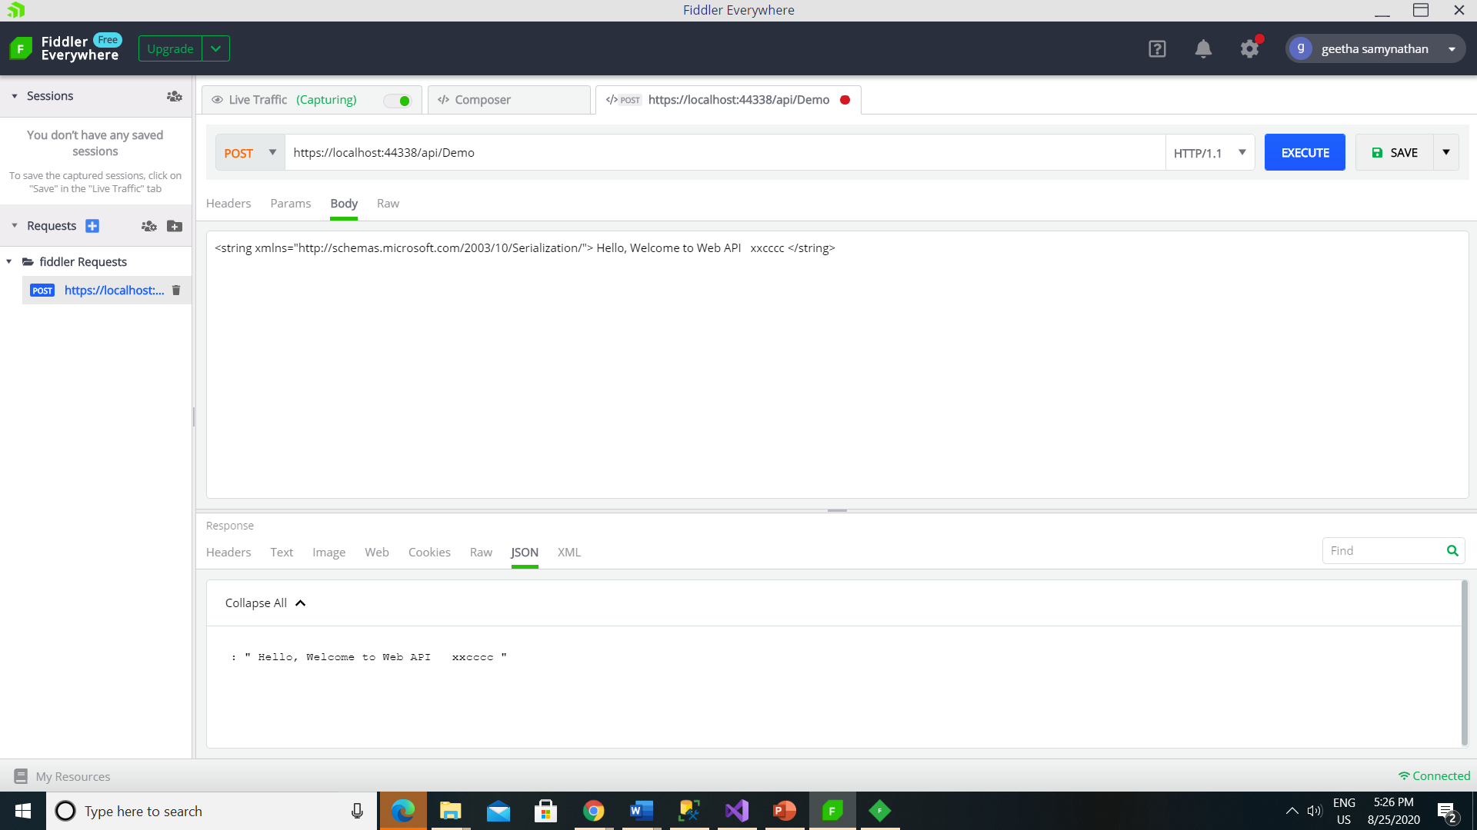

Slide 26
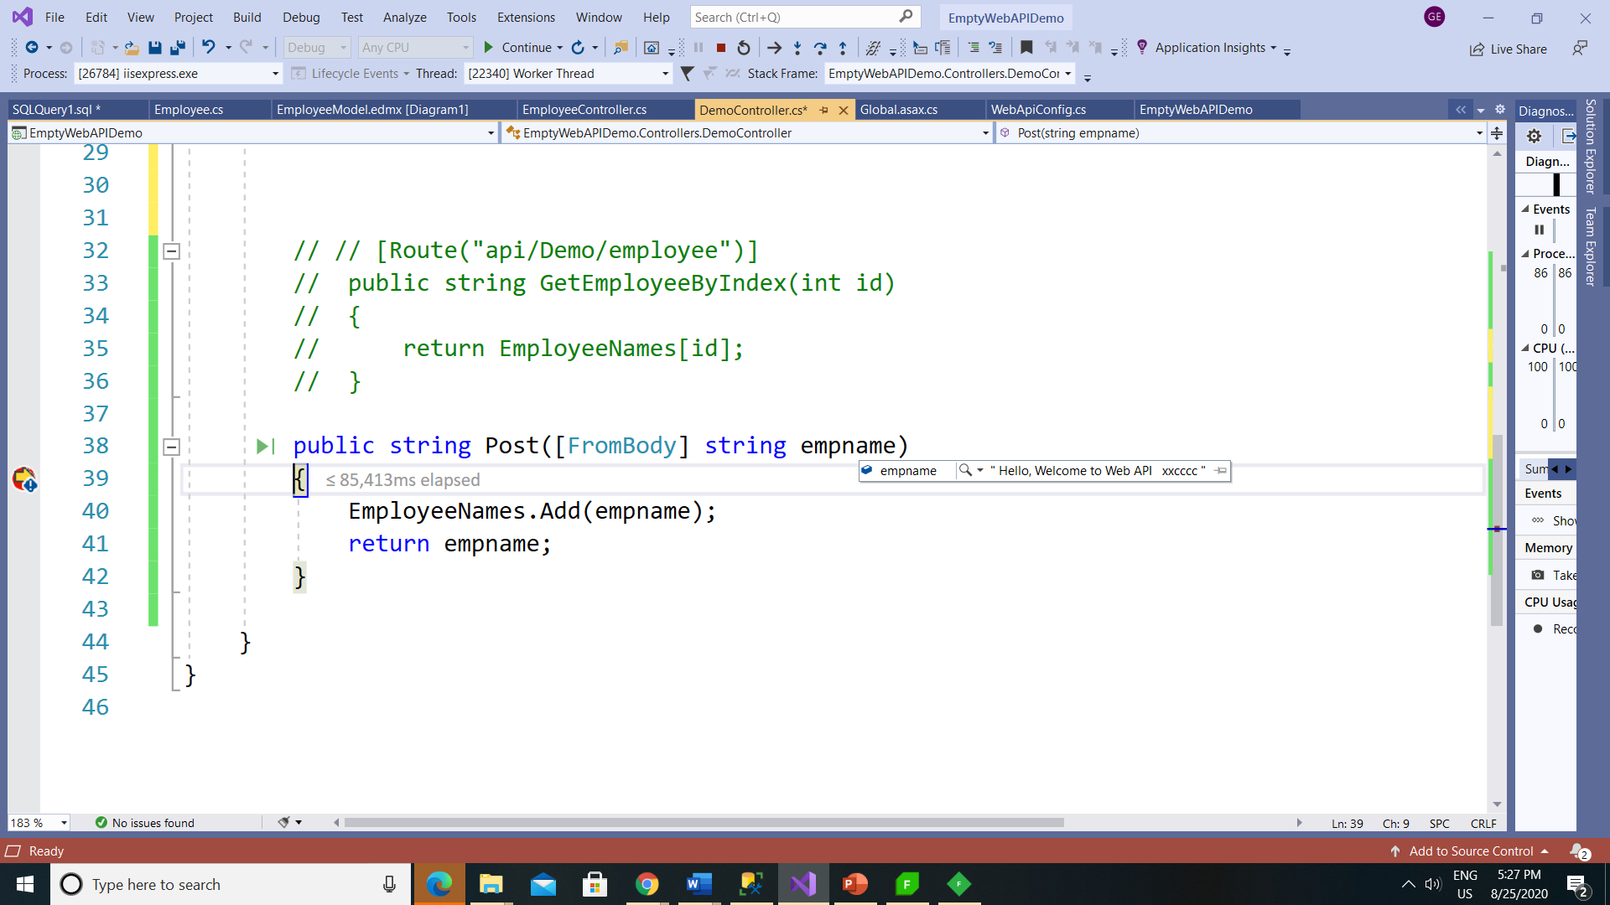

Slide 27
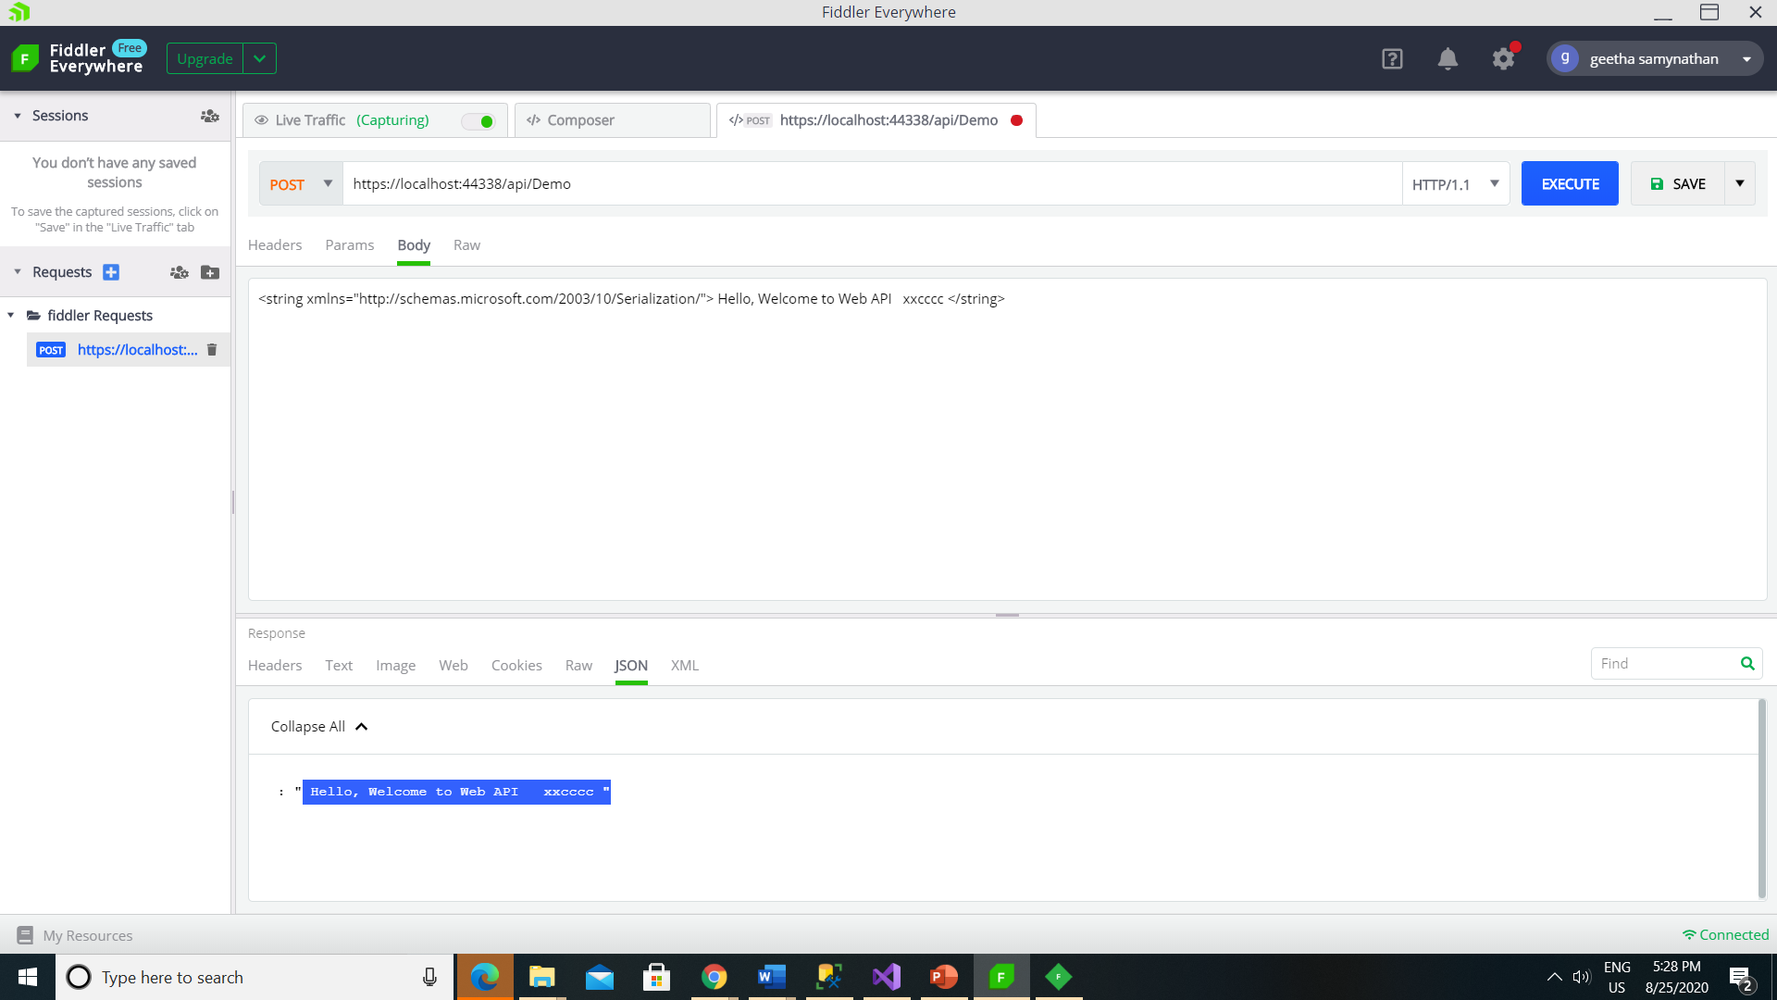

Slide 28
Parameter Binding
HTTP Method | Query String | Request Body
GET | Primitive Type, Complex Type | NA
POST | Primitive Type | Complex Type
PUT | Primitive Type | Complex Type
PATCH | Primitive Type | Complex Type
DELETE | Primitive Type, Complex Type | NA

Slide 29
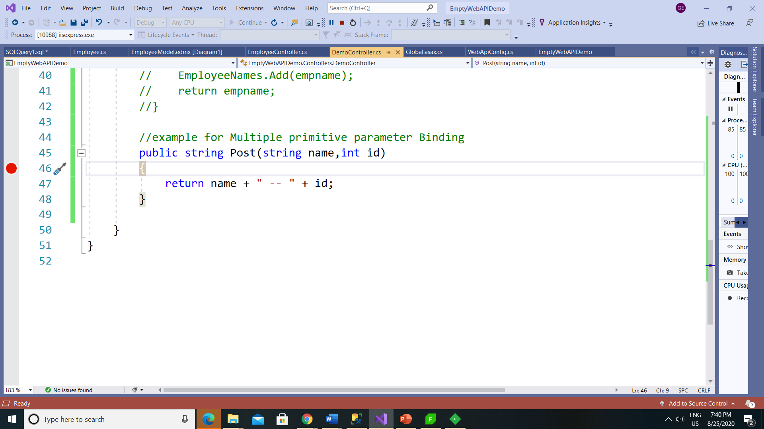

Slide 30
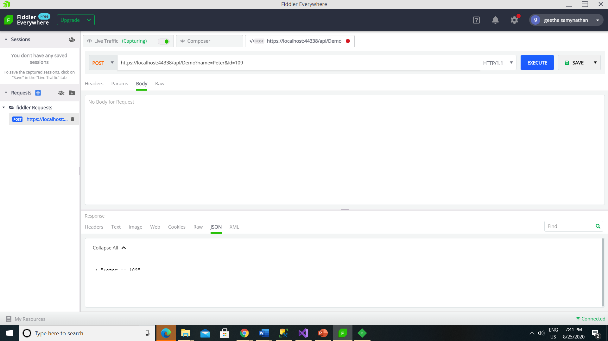

Slide 31
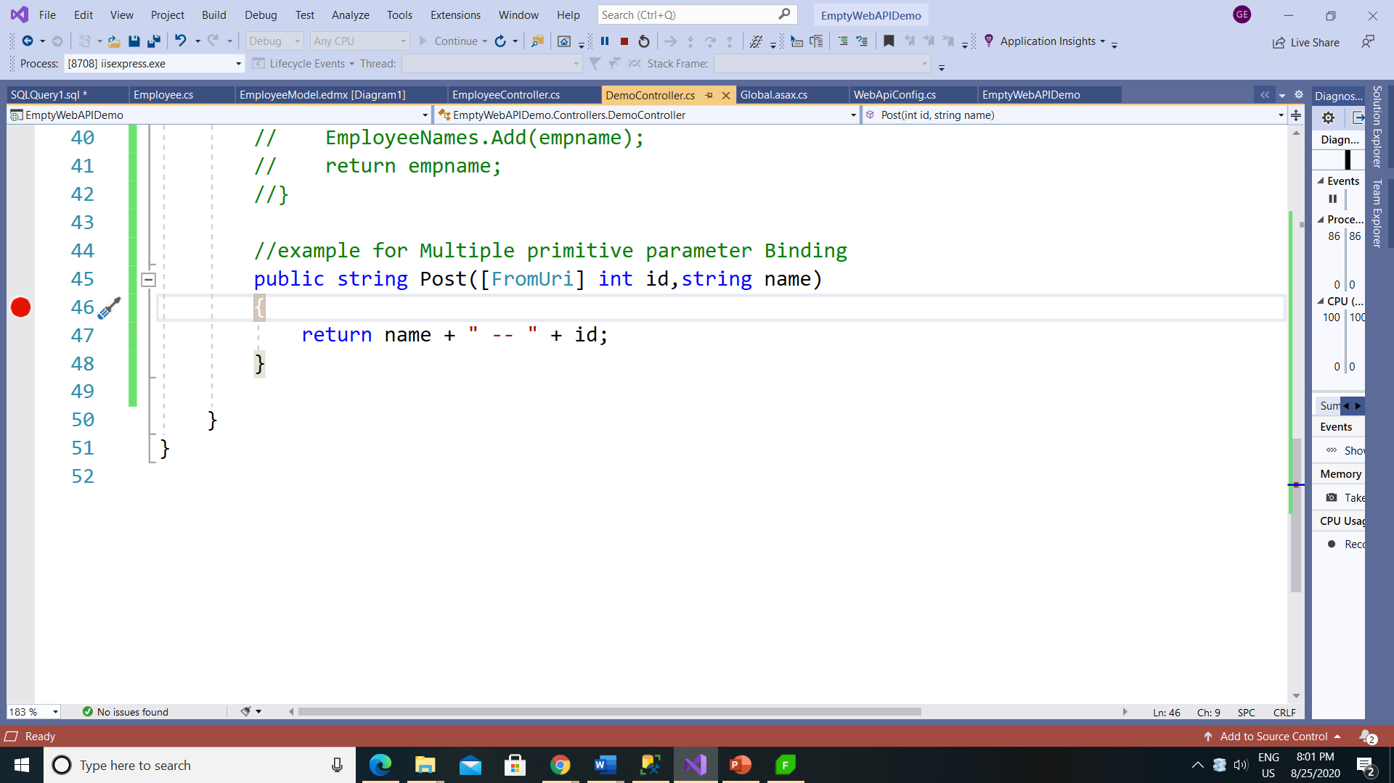

Slide 32
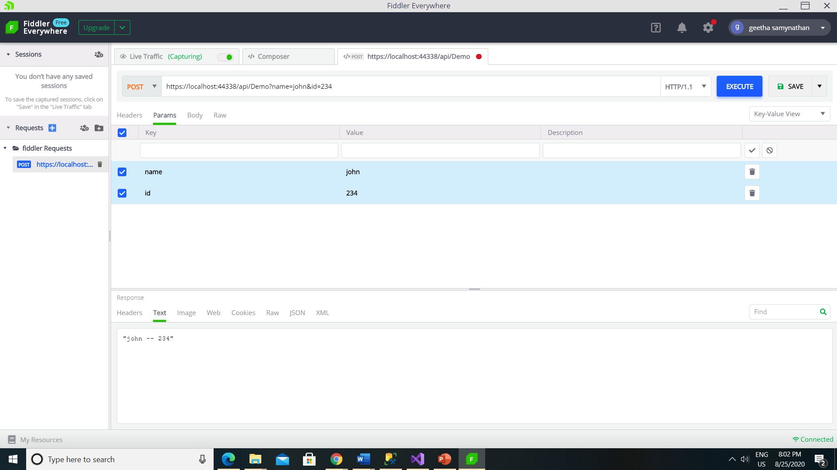

Slide 33
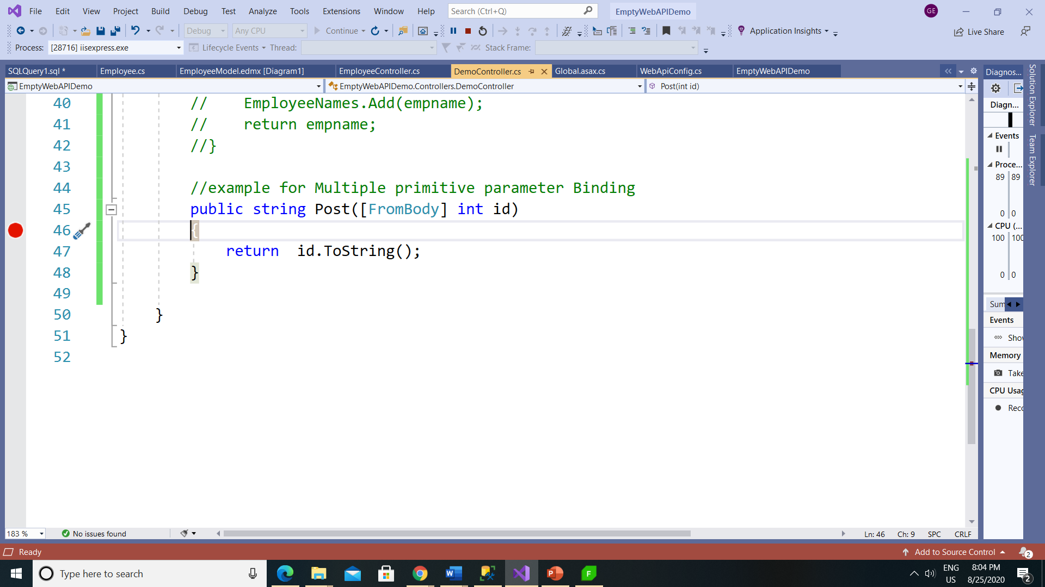

Slide 34
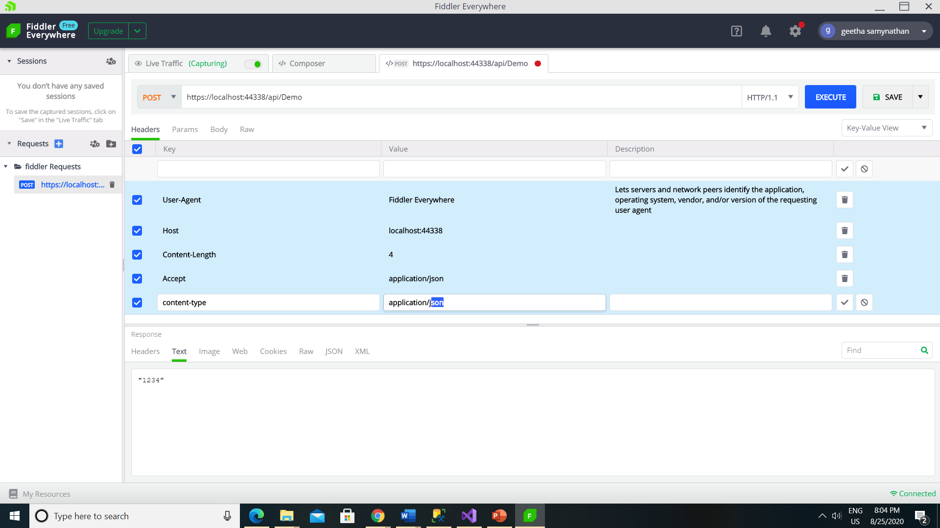

Slide 35
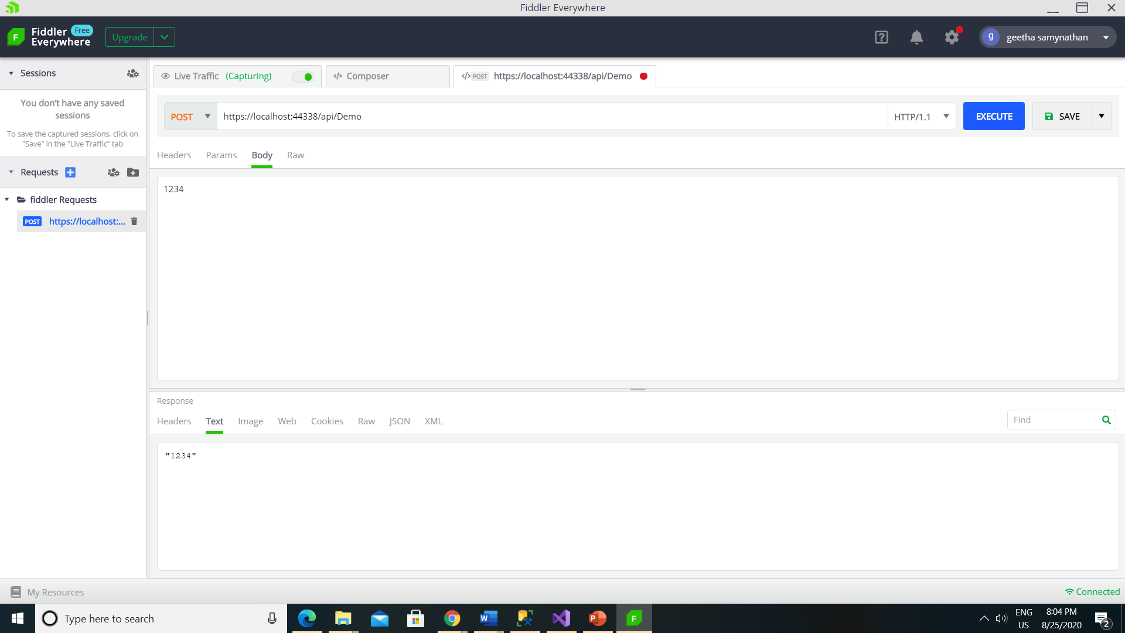

Slide 36
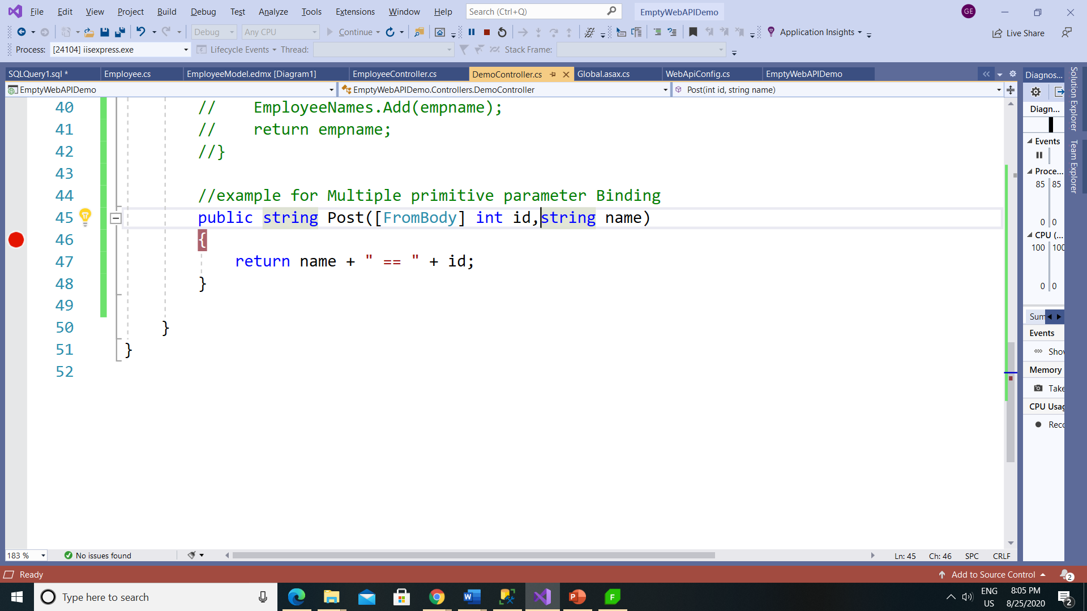

Slide 37
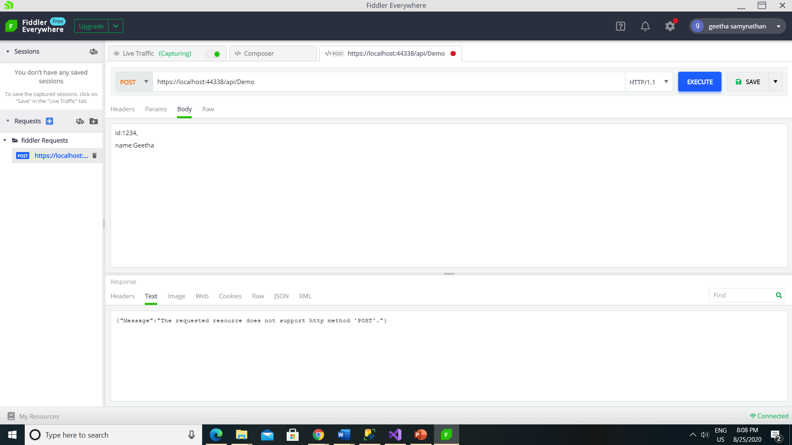

Slide 38
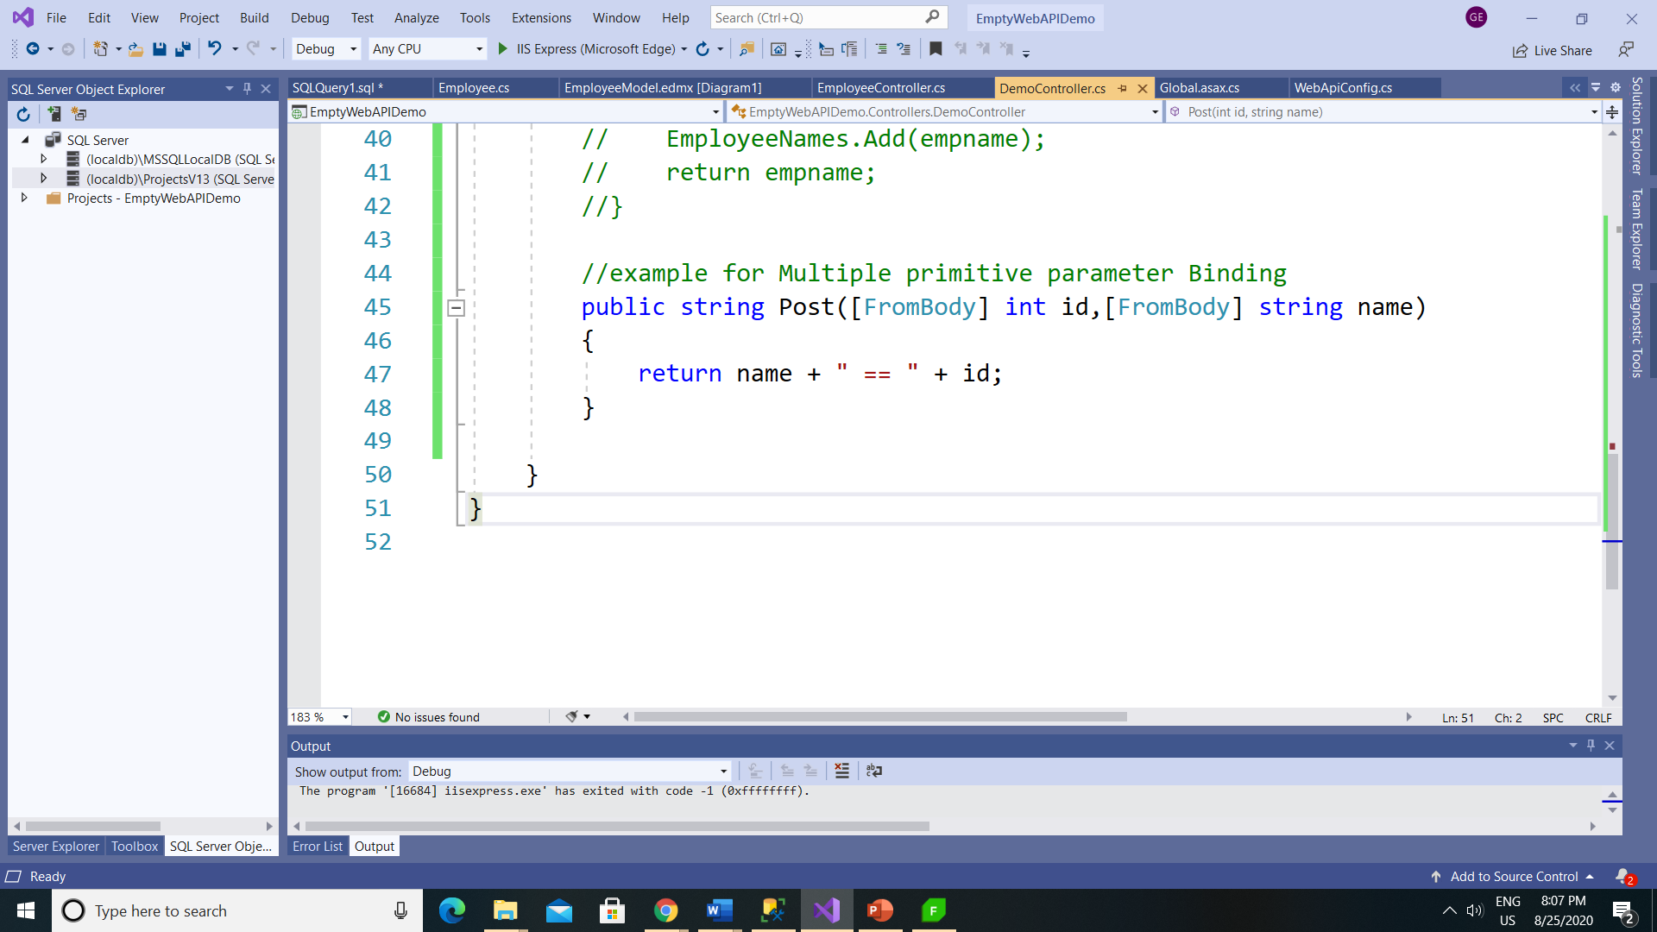

Slide 39
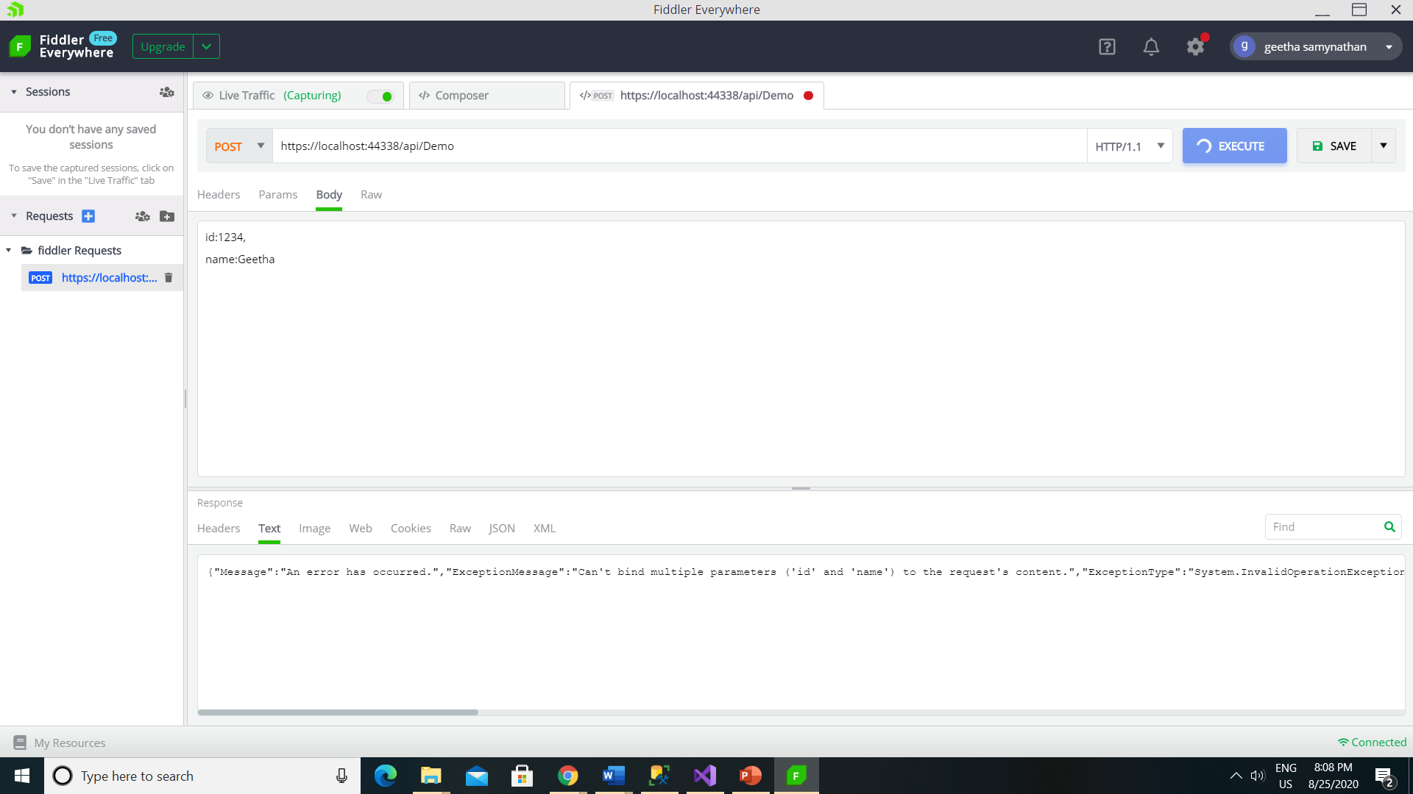

Slide 40
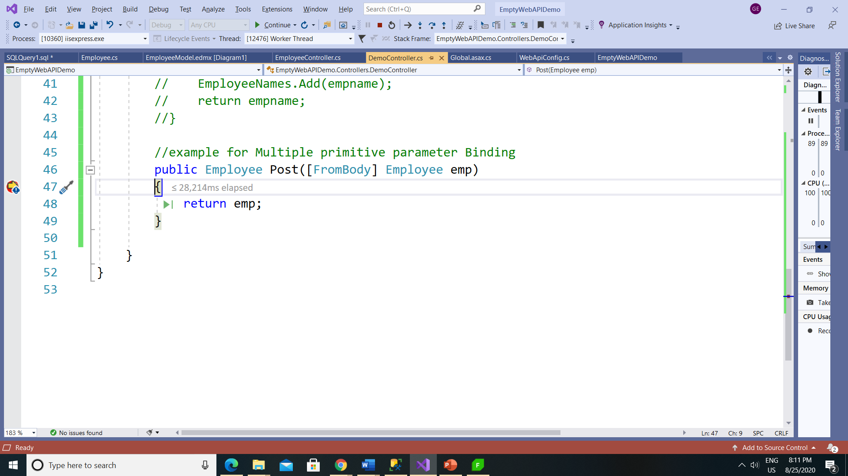

Slide 41
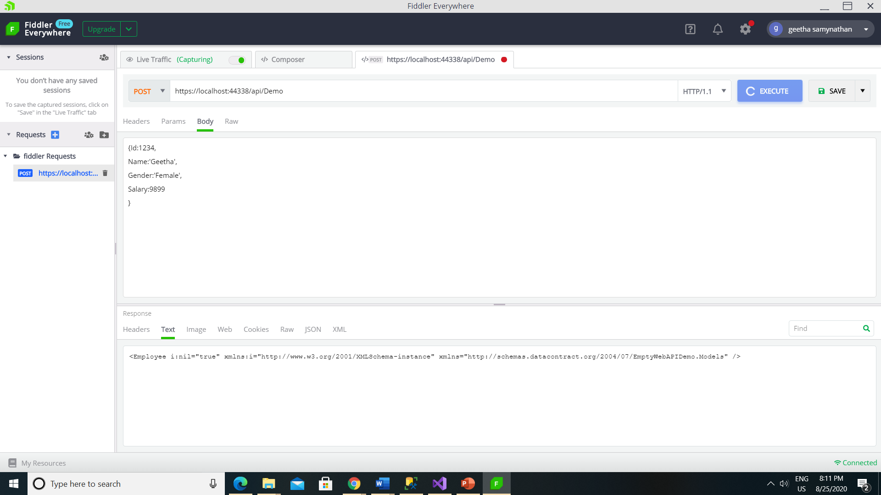

Slide 42
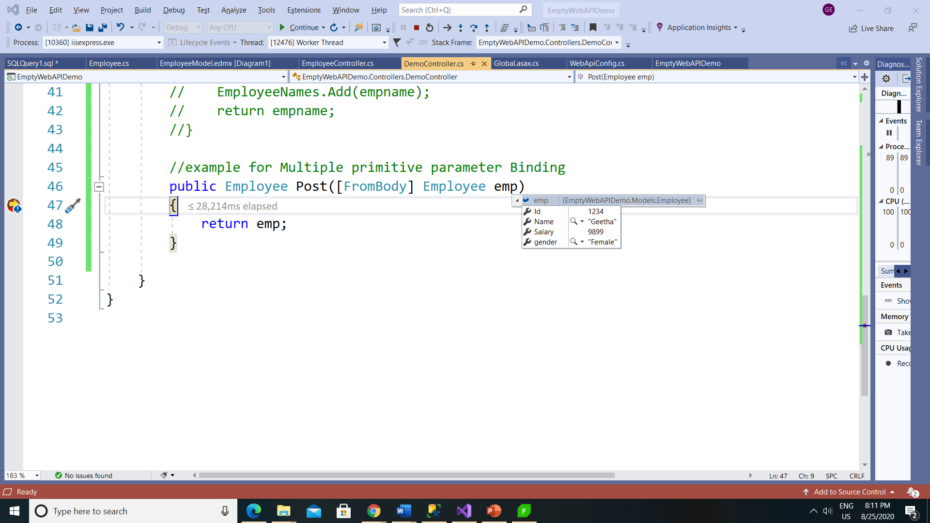

Slide 43
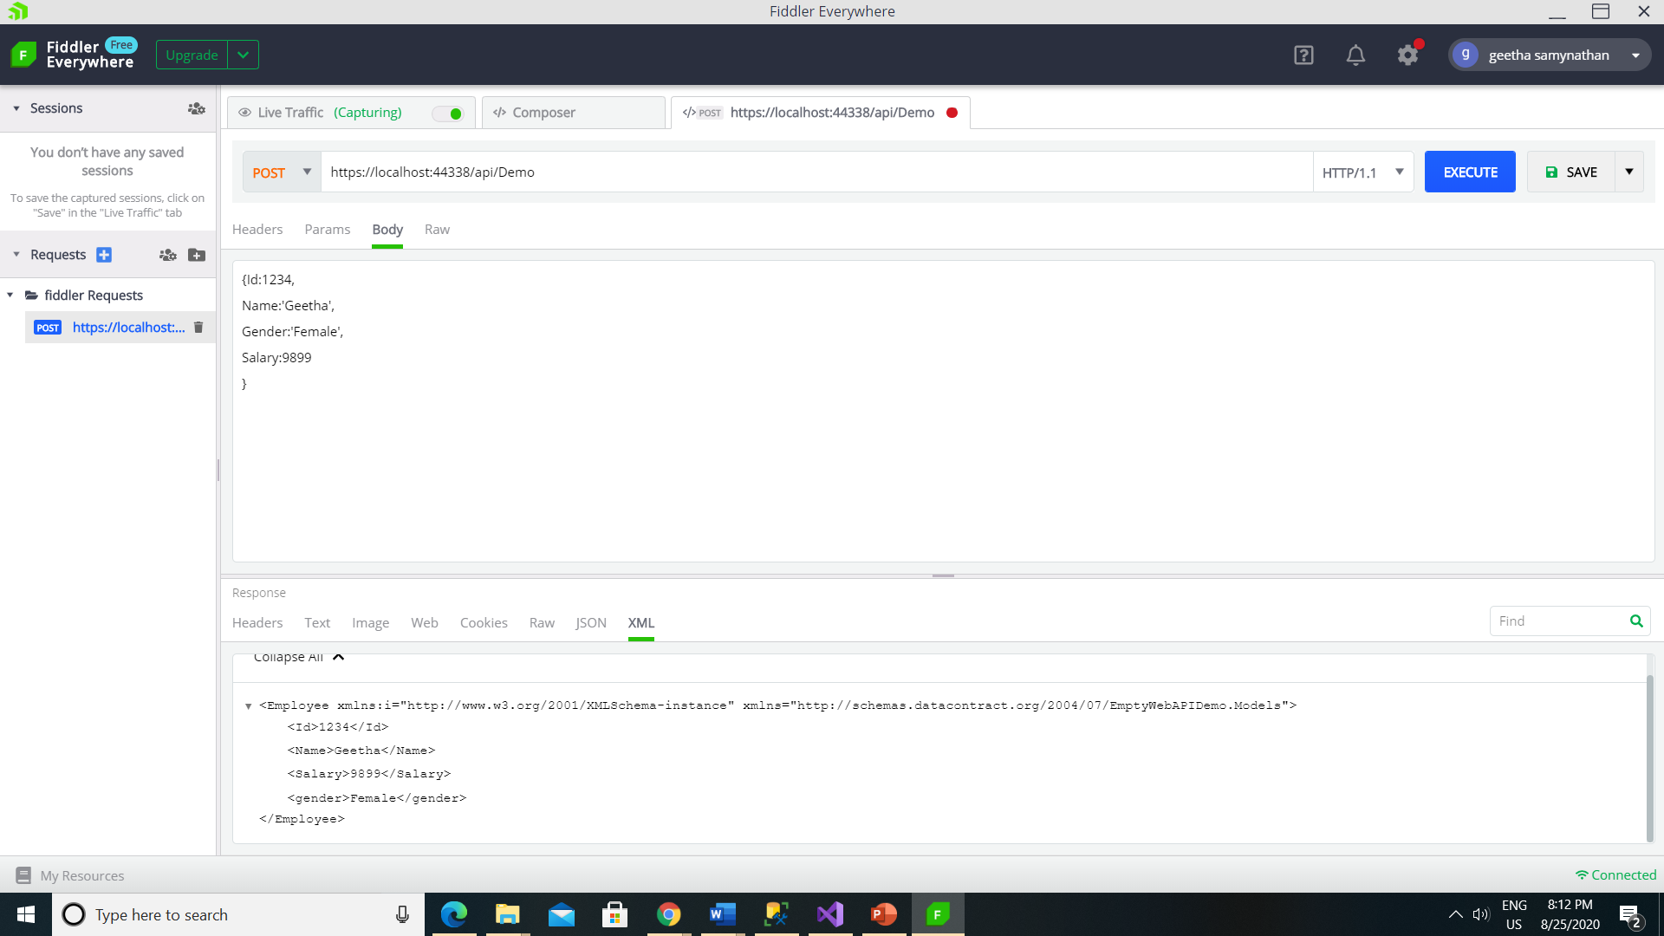

Slide 44
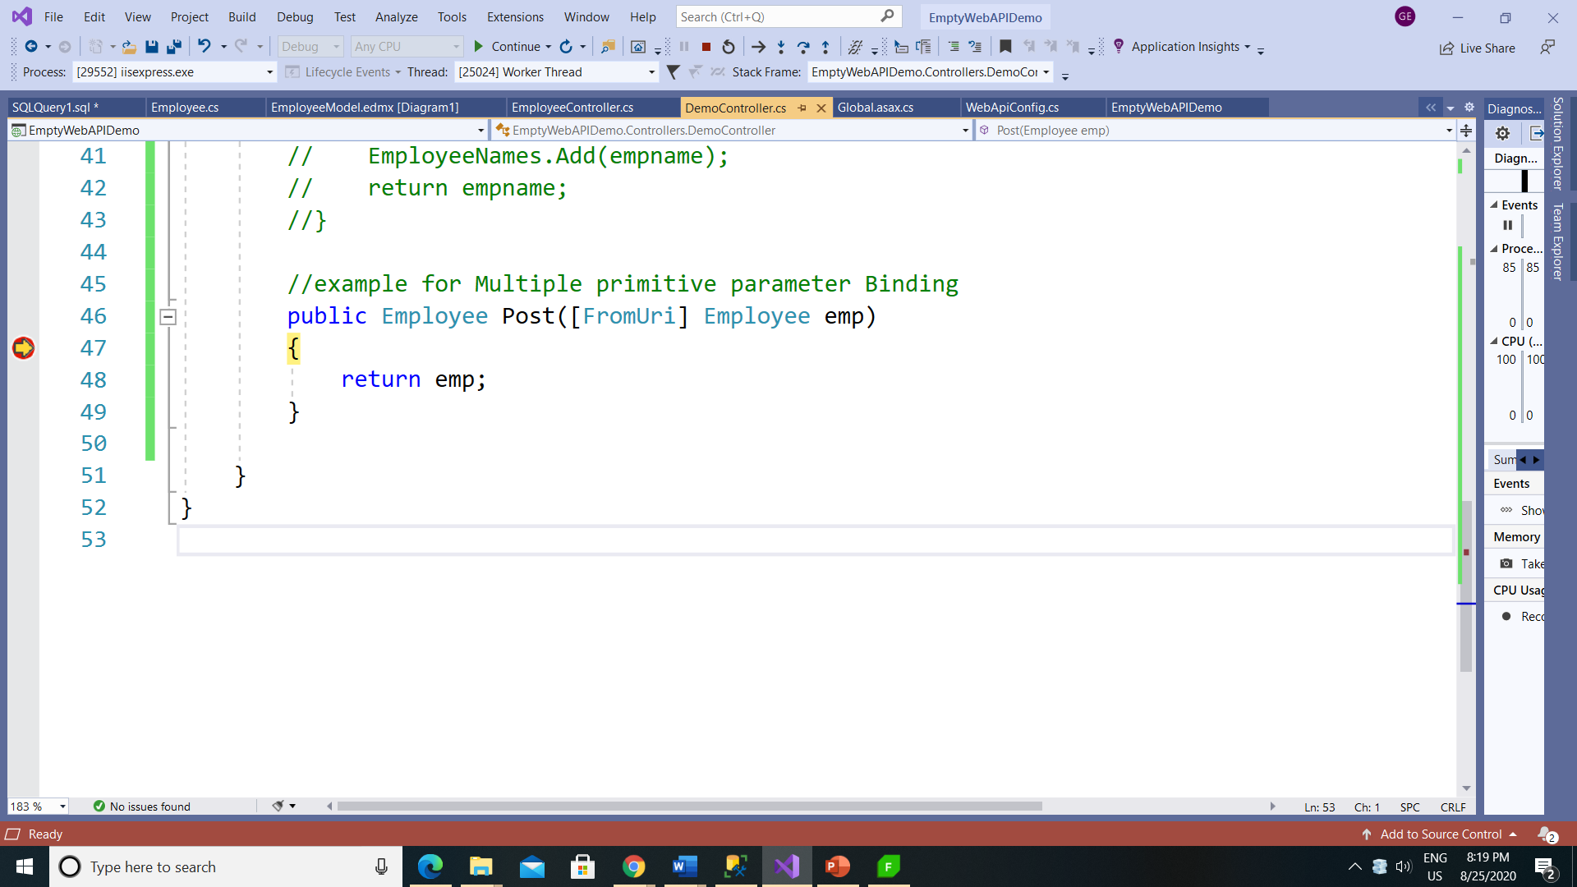

Slide 45


Slide 46
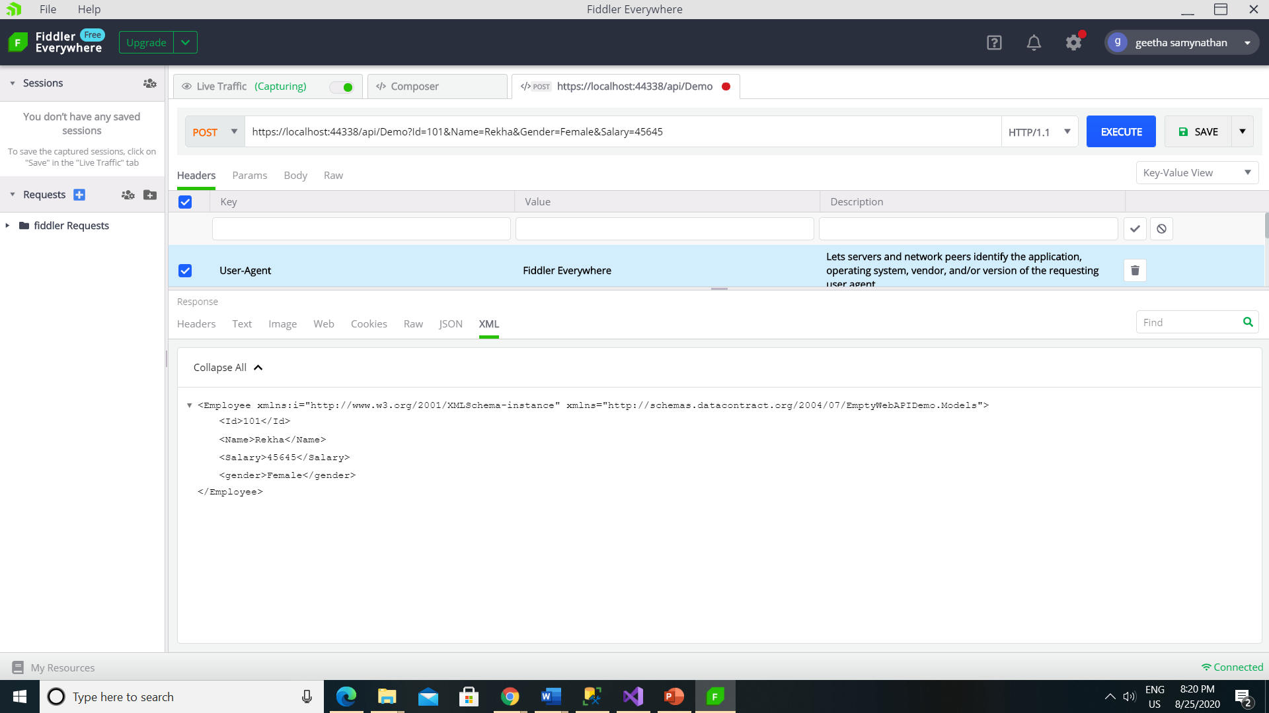

Slide 47
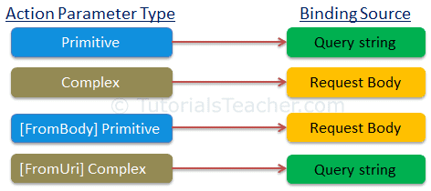

Slide 48
MediaTypeFormatter
How to return only JSON from ASP.NET Web API Service irrespective of the Accept header value
How to return only XML from ASP.NET Web API Service irrespective of the Accept header value

Slide 49
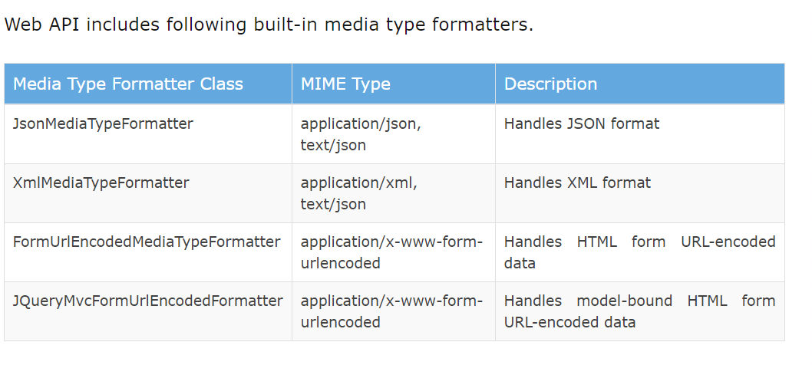
What is MediaTypeFormatter
MediaTypeFormatter is an abstract class from which JsonMediaTypeFormatter and XmlMediaTypeFormatter classes inherit from. JsonMediaTypeFormatter handles JSON and XmlMediaTypeFormatter handles XML.

Slide 50
How to return only JSON from ASP.NET Web API Service irrespective of the Accept header value
Include the following line in Register() method of WebApiConfig.cs file in App_Start folder. This line of code completely removes XmlFormatter which forces ASP.NET Web API to always return JSON irrespective of the Accept header value in the client request. Use this technique when you want your service to support only JSON and not XML.
With this change, irrespective of the Accept header value (application/xml or application/json), the Web API service is always going to return JSON.
config.Formatters.Remove(config.Formatters.XmlFormatter);

Slide 51
How to return only XML from ASP.NET Web API Service irrespective of the Accept header value
Include the following line in Register() method of WebApiConfig.cs file in App_Start folder. This line of code completely removes JsonFormatter which forces ASP.NET Web API to always return XML irrespective of the Accept header value in the client request. Use this technique when you want your service to support only XML and not JSON.
config.Formatters.Remove(config.Formatters.JsonFormatter);
With this change, irrespective of the Accept header value (application/xml or application/json), the Web API service is always going to return XML.

Slide 52
HTTP Response Code
Code | Description | Notes
400 | Bad Request | This is the generic error that tells us someone created a bad request. Perhaps required fields are missing or header values are not filled in.
401 | Unauthorized | Indicates that authentication has failed. This could be because of an expired, missing, or invalid token.
403 | Forbidden | Indicates that authorization failed. Alternatively, you can also use 404 so that the consumer doesn’t know that the resource even exists.
404 | Not Found | The requested resource is not found. Companies like GitHub also use 404 if you try to access a resource that you do not have the authorization to access.
500 | Internal Server Error | When something goes wrong on the server, the consumer can’t do anything about it. Just let them know there’s a problem and that they should try again later or contact support.

Slide 53
ASP.NET Web API 2 action method return types

Slide 54
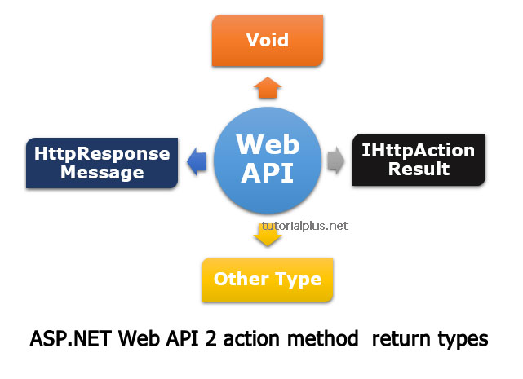

Slide 55
Void
public class SampleController : ApiController
{
public void Post()
{
}
}

Slide 56
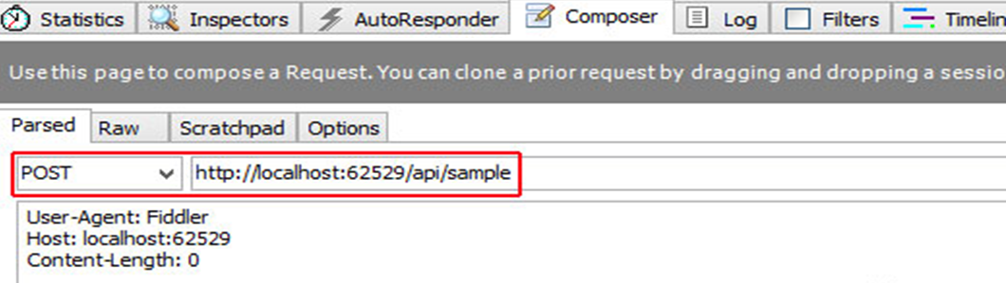
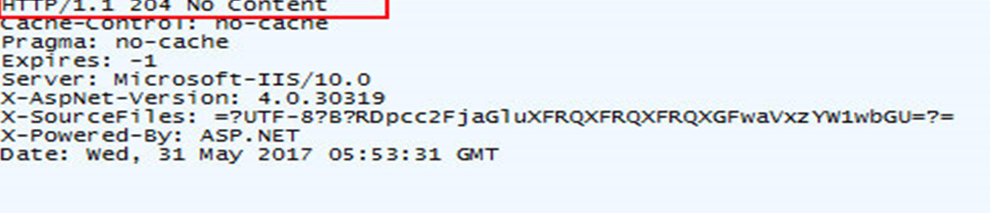

Slide 57
HttpResponseMessage
When Web API return type is HttpResponseMessage, Web API converts the return value directly into an HTTP response message.
We can set the status code, content as per our requirement.
In the following example a web API with HttpResponseMessage return:
Example

Slide 58
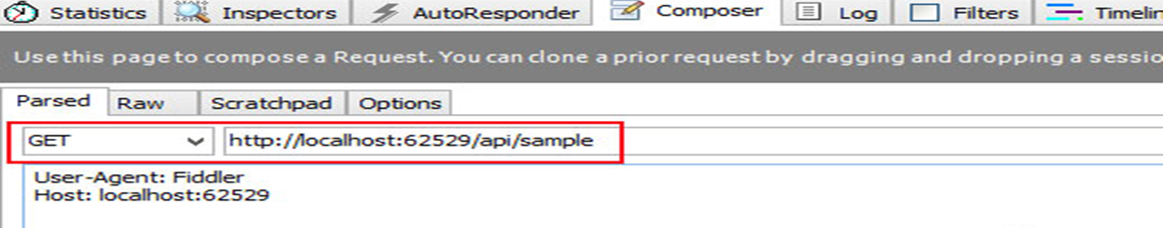
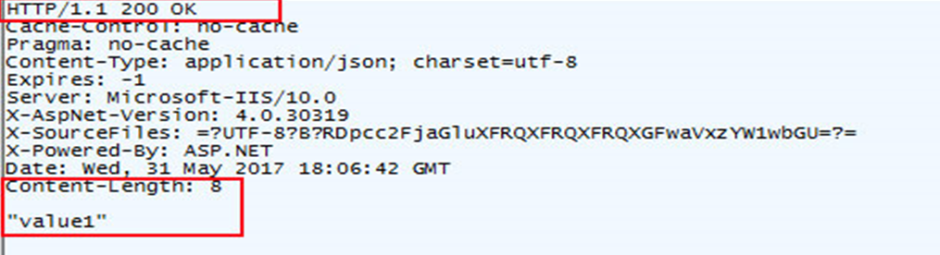
public HttpResponseMessage Get()
{
HttpResponseMessage response = Request.CreateResponse(HttpStatusCode.OK, "value1");
return response;
}

Slide 59
public class Country
{
public int Id { get; set; }
public string CountryName { get; set; }
public string Capital { get; set; }
}
public HttpResponseMessage Get()
{
// list of Countries
List<Country> Countries = new List<Country>();
Country country = new Country();
country.Id = 1;
country.CountryName = "India";
country.Capital = "Delhi";
Countries.Add(country);
//Countries to the response body.
HttpResponseMessage response = Request.CreateResponse(HttpStatusCode.OK, Countries);
return response;
}

Slide 60
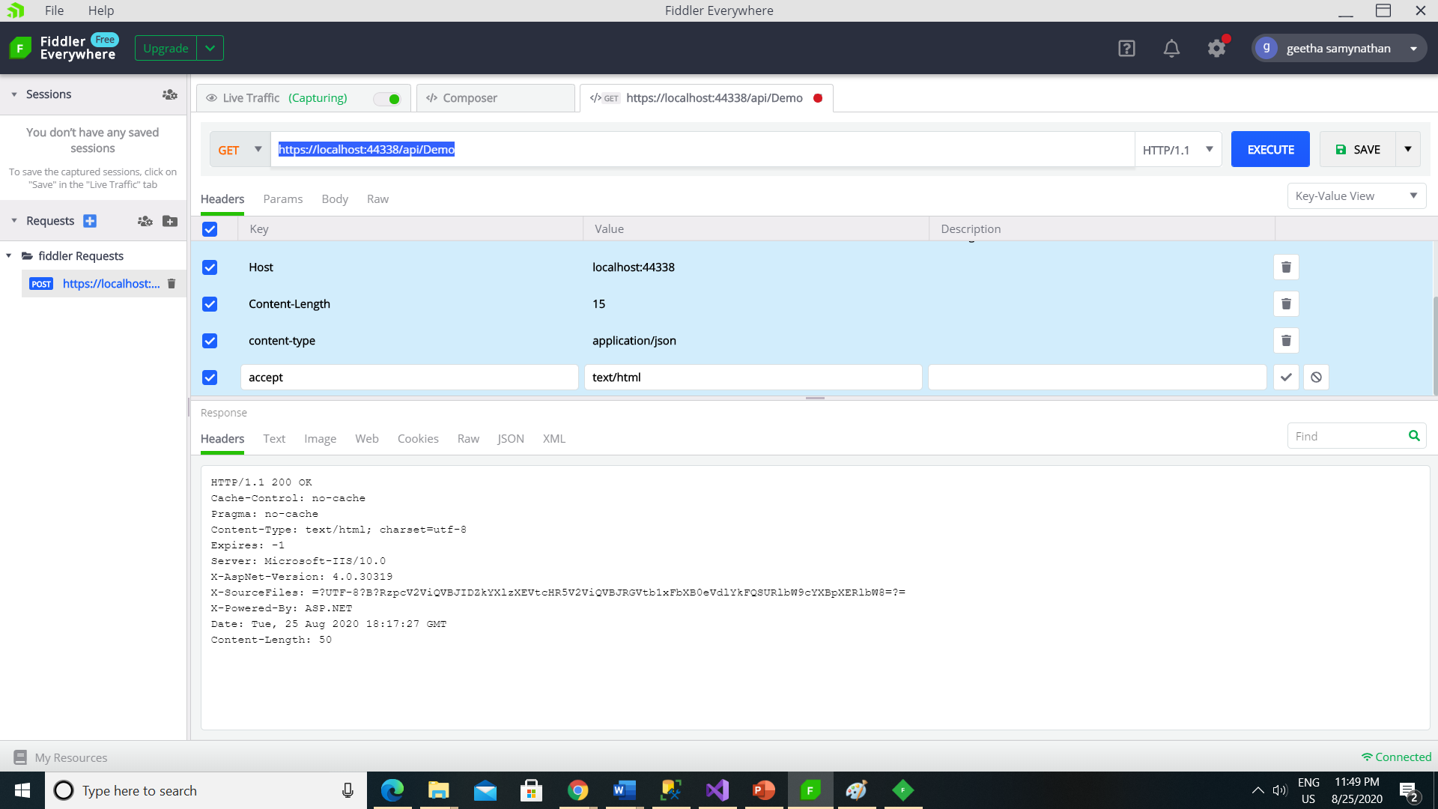

Slide 61
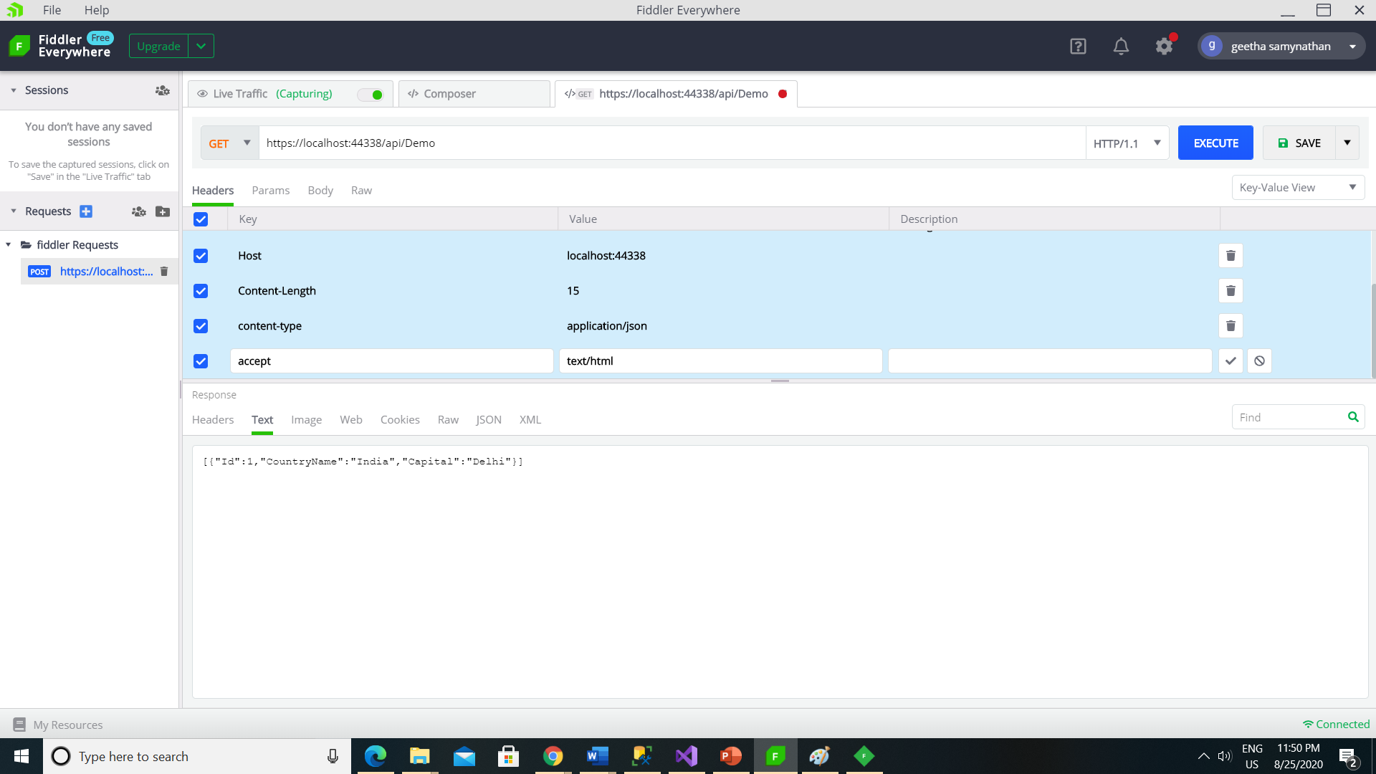

Slide 62
IHttpActionResult
IHttpActionResult is introduced in Web API 2, IHttpActionResult interface acts like a factory for HttpResponseMessage.
There are some advantages of using the IHttpActionResult over HttpResponseMessage
The code is cleaner and easier to read
Unit testing for controller action methods become easy
It comes with custom built in responses
Ok
NotFound
Exception
Unauthorized
BadRequest
Conflict
Redirect

Slide 63
public IHttpActionResult Get(int id)
{
// list of Countries
List<Country> Countries = new List<Country>();
Country country = new Country();
country.ID = 1;
country.CountryName = "USA";
country.Capital = "Washington";
Countries.Add(country);
//finding country based on provided id
var result = Countries.FirstOrDefault(x => x.ID == id);
if (result == null)
{
//create a 404 (Not Found) response
return NotFound();
}
else
{
//creates a 200 (OK) response that contains the country
return Ok(result);
}
}

Slide 64
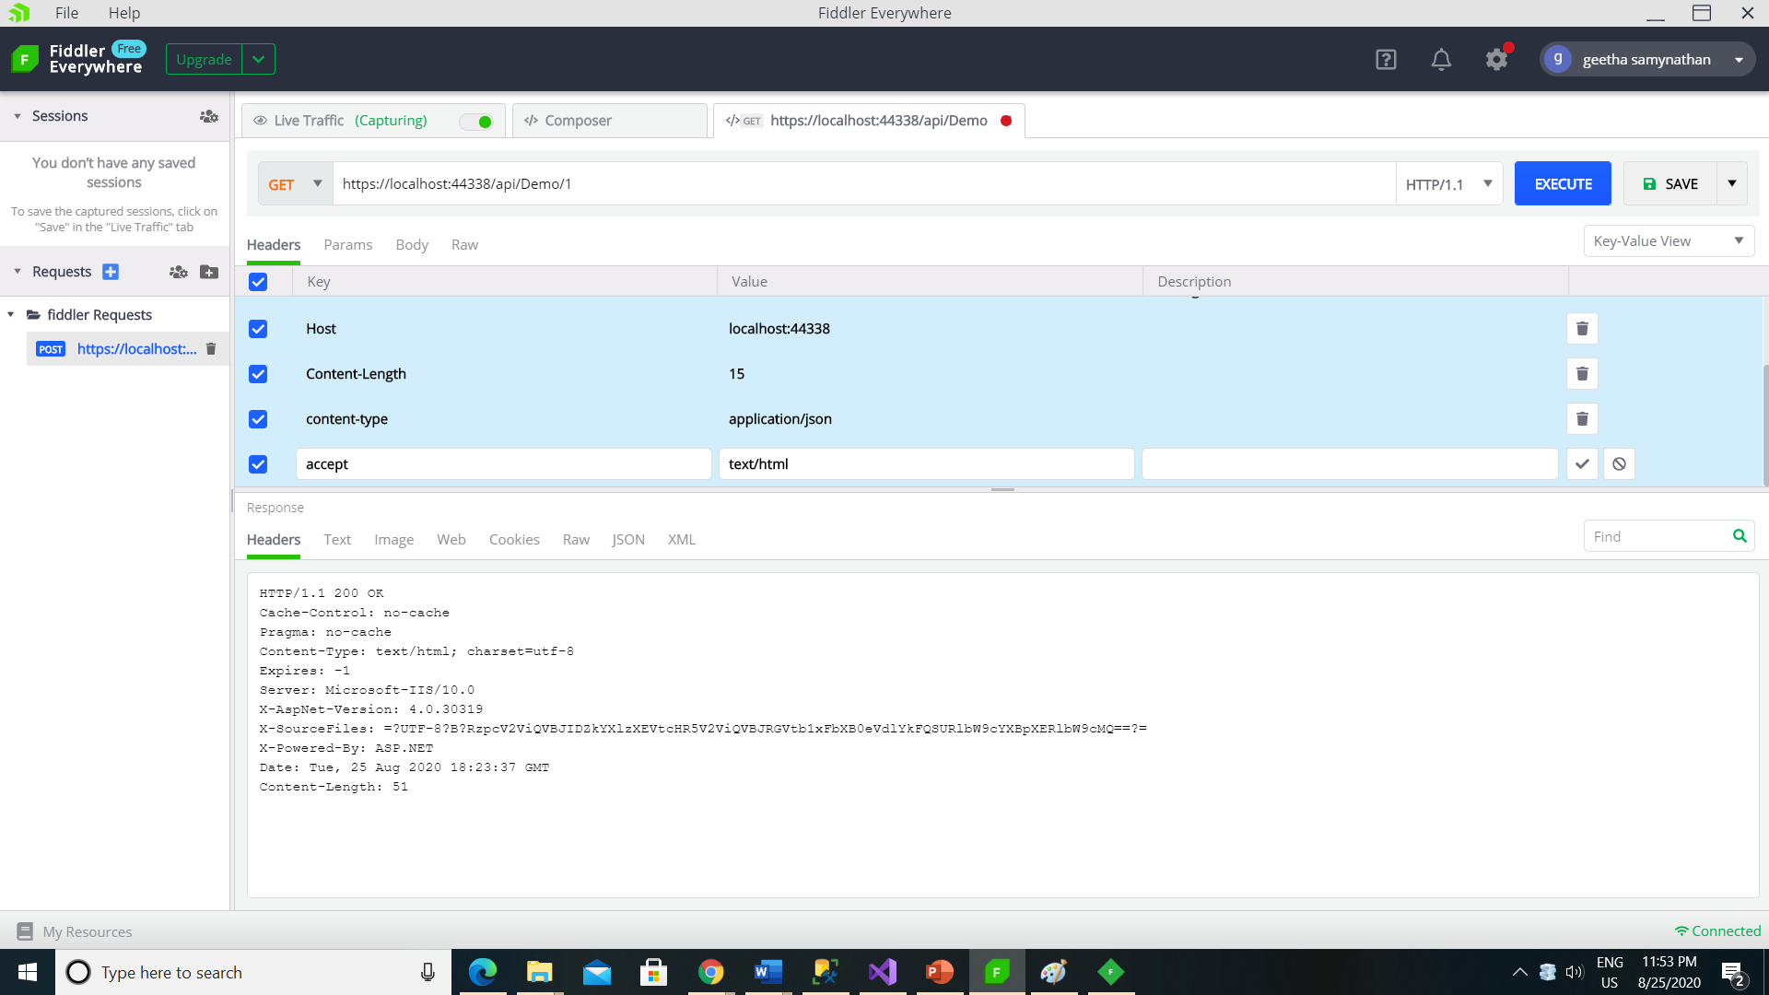

Slide 65


Slide 66


Slide 67
Other type or Complex type
A Web API can return other or custom complex type
Web API serialize value and return it into the response body
The response status code 200 OK
But in this approach we cannot directly return an error code, still we can throw an HttpResponseException for error codes

Slide 68
public IEnumerable<Country> Get()
{
List<Country> Countries = new List<Country>();
Country country = new Country();
country.ID = 1;
country.CountryName = "USA";
country.Capital = "Washington";
Countries.Add(country);
return Countries;
}

Slide 69
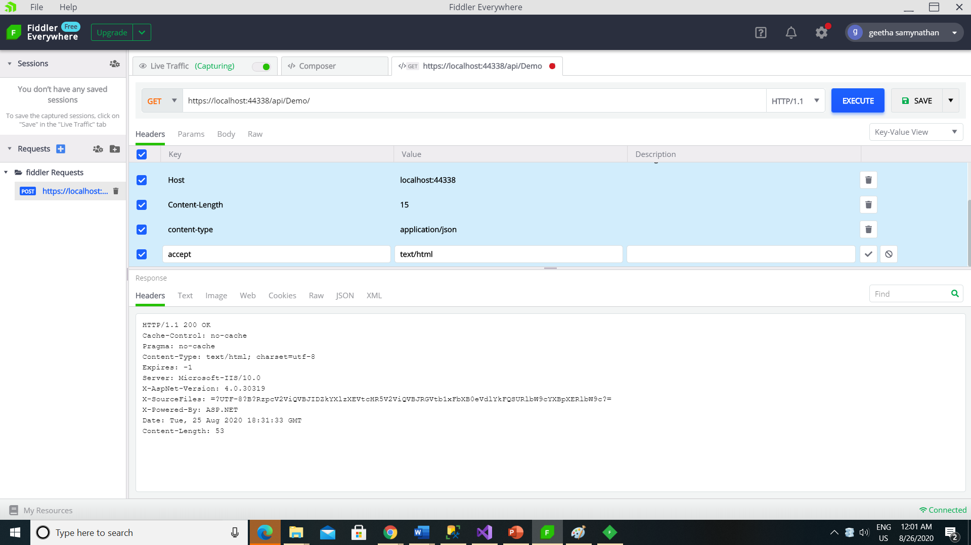

Slide 70
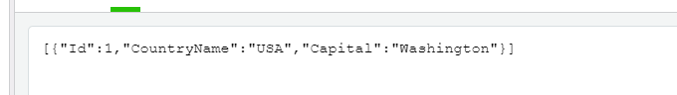

Slide 71
Parameter Binding with HttpResponseMessage
public HttpResponseMessage GET()
{
using (FujitsuDBEntities dbContext = new FujitsuDBEntities())
{
var Employees = dbContext.Employees.ToList();
return Request.CreateResponse(HttpStatusCode.OK, Employees);
}
}

Slide 72
Depending on the value we specify for query string parameter gender, the Get() method should return the data.
/api/employees?gender=all Return All Employees
/api/employees?gender=Male Return All Male Employees
/api/employees?gender=Female Return All Female Employees
If the value for gender is not Male, Female or All, then the service should return status code 400 Bad Request. For example, if we specify ABC as the value for gender, then the service should return status code 400 Bad Request with the following message.
Value for gender must be Male, Female or All. ABC is invalid.

Slide 73
public HttpResponseMessage Get(string gender = "All")
{
using (FujitsuDBEntities dbContext = new FujitsuDBEntities())
{
switch (gender.ToLower())
{
case "all":
return Request.CreateResponse(HttpStatusCode.OK,
dbContext.Employees.ToList());
case "male":
return Request.CreateResponse(HttpStatusCode.OK,
dbContext.Employees.Where(e => e.gender.ToLower() == "male").ToList());
case "female":
return Request.CreateResponse(HttpStatusCode.OK,
dbContext.Employees.Where(e => e.gender.ToLower() == "female").ToList());
default:
return Request.CreateErrorResponse(HttpStatusCode.BadRequest,
"Value for gender must be Male, Female or All. " + gender + " is invalid.");
}
}
}

Slide 74
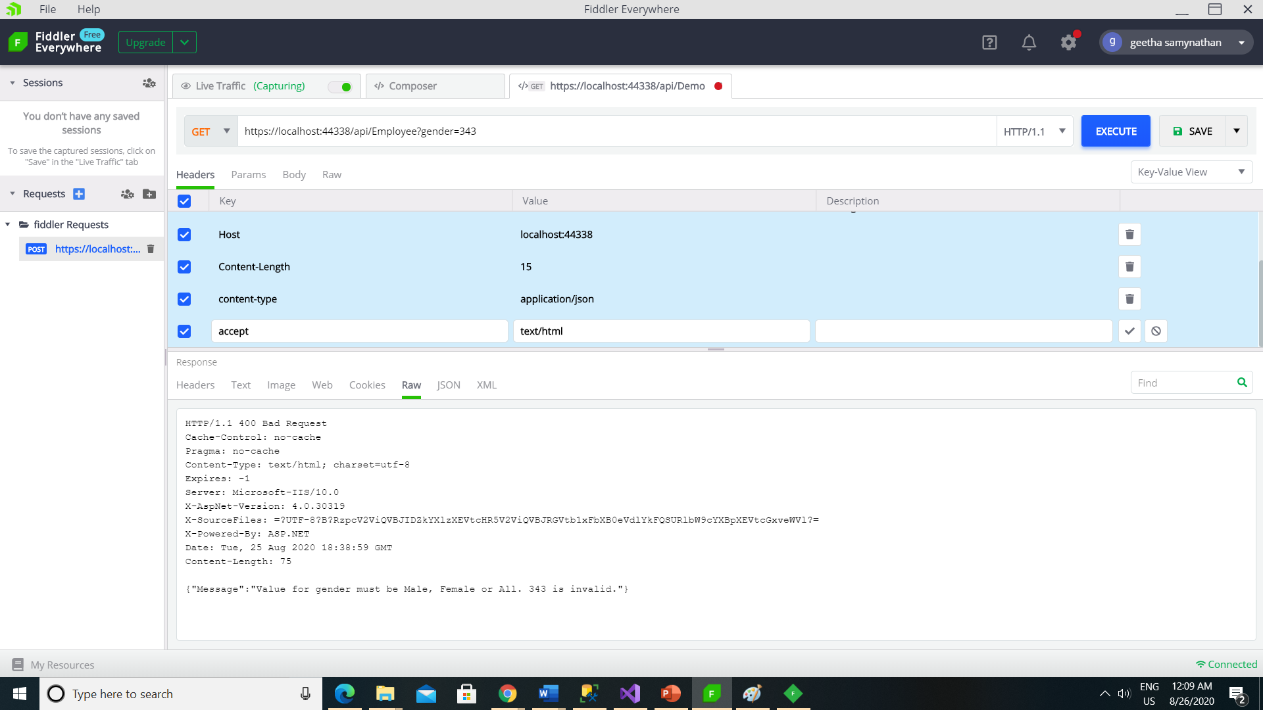

Slide 75
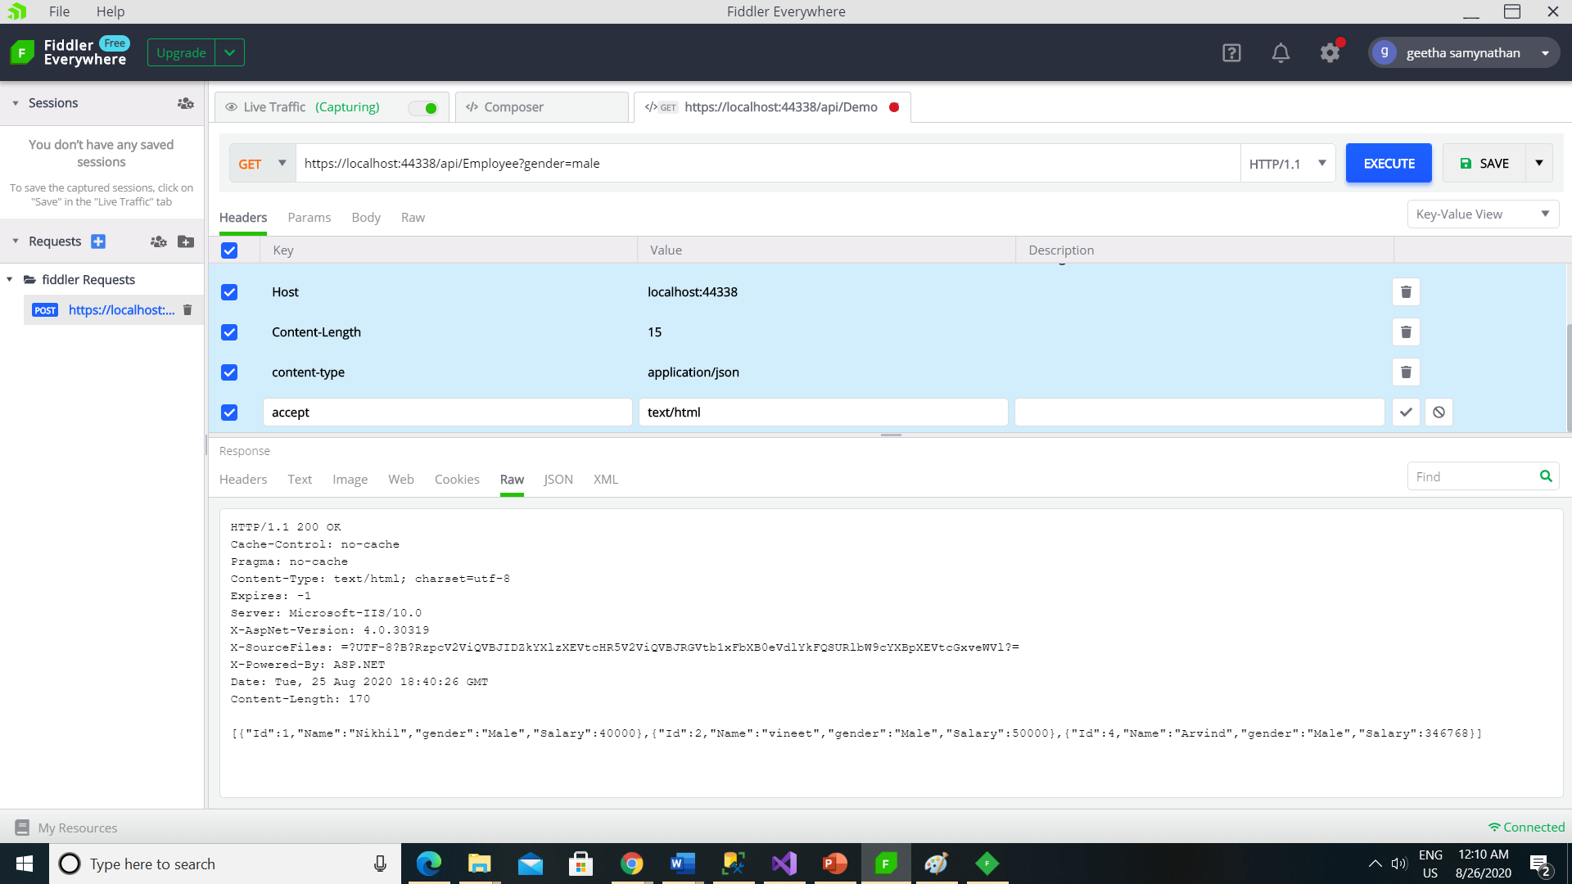

Slide 76


Slide 77
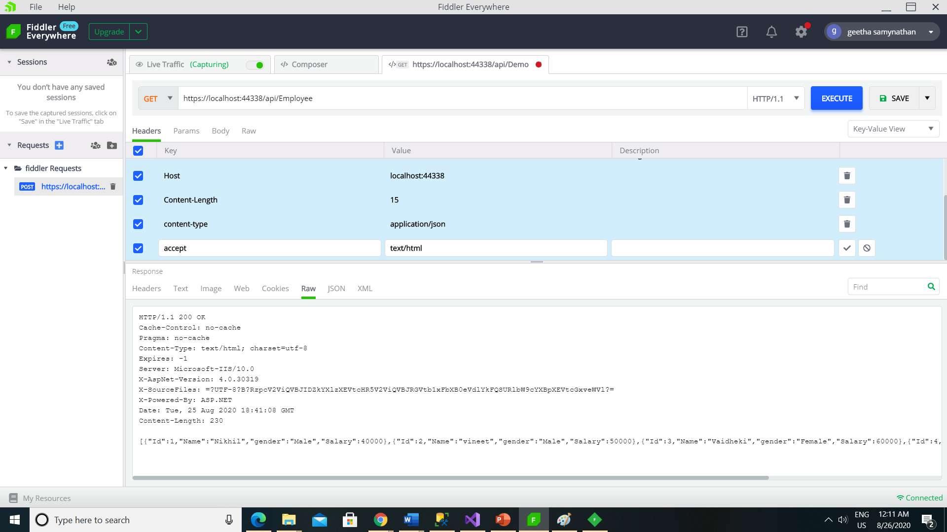

Slide 78
Understanding FromBody and FromUri attributes.

Slide 79
public HttpResponseMessage Put(int id, Employee employee)
{
try
{
using (EmployeeDBContext dbContext = new EmployeeDBContext())
{
var entity = dbContext.Employees.FirstOrDefault(e => e.ID == id);
if (entity == null)
{
return Request.CreateErrorResponse(HttpStatusCode.NotFound,
"Employee with Id " + id.ToString() + " not found to update");
}
else
{
entity.FirstName = employee.FirstName; entity.LastName = employee.LastName;
entity.Gender = employee.Gender; entity.Salary = employee.Salary;
dbContext.SaveChanges();
return Request.CreateResponse(HttpStatusCode.OK, entity);
} } }
catch (Exception ex)
{
return Request.CreateErrorResponse(HttpStatusCode.BadRequest, ex);
}
}

Slide 80
To update employee details whose Id is 1 we issue a Put request to the URI /api/employee/1
Note: Query string parameter names must match with the name of an action method parameter. However, they can be in a different order.
If you are using Fiddler, the PUT request is as shown below. Notice the Id of the employee is in the URI and the employee data is in the request body.

Slide 81


Slide 82
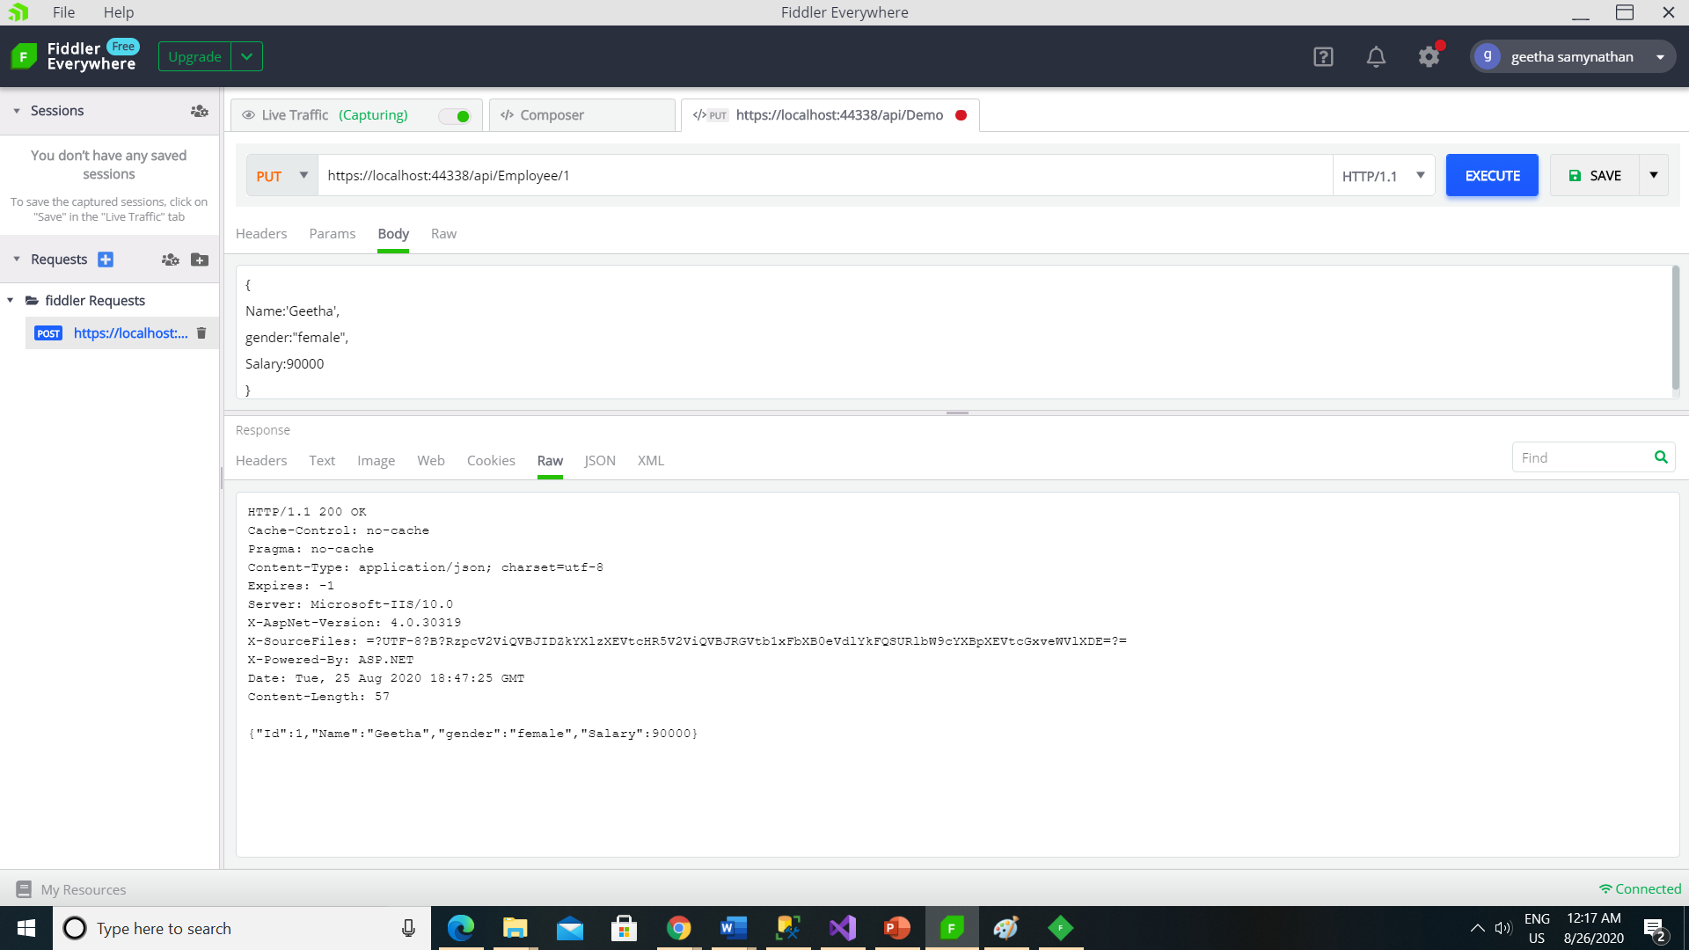

Slide 83


Slide 84


Slide 85


Slide 86


Slide 87


Slide 88
public HttpResponseMessage Put([FromBody] int id, [FromUri] Employee employee)
{
try
{
using (FujitsuDBEntities dbContext = new FujitsuDBEntities())
{
var entity = dbContext.Employees.FirstOrDefault(e => e.Id == id);
if (entity == null)
{
return Request.CreateErrorResponse(HttpStatusCode.NotFound,
"Employee with Id " + id.ToString() + " not found to update");
}
else
{
entity.Name = employee.Name;
entity.gender = employee.gender;
entity.Salary = employee.Salary;
dbContext.SaveChanges();
return Request.CreateResponse(HttpStatusCode.OK, entity);
}
}
}
catch (Exception ex)
{
return Request.CreateErrorResponse(HttpStatusCode.BadRequest, ex);
}
}

Slide 89


Slide 90

HttpClient

